Slide 1
Navigating Landlord Insolvency for Tenants
October 29 2026
www.acto.ca

Slide 2
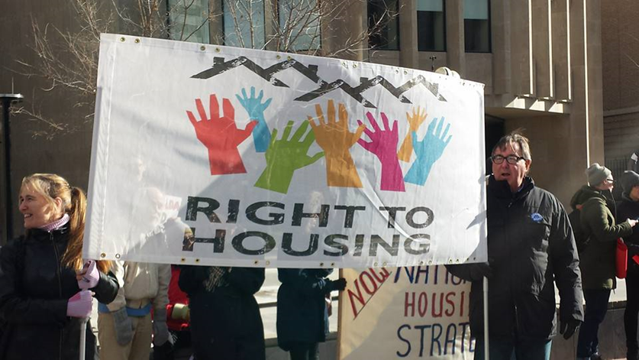
ADVOCACY CENTRE FOR TENANTS ONTARIO (ACTO)
ACTO is one of 71 community legal clinics in Ontario, funded by Legal Aid Ontario (LAO)
ACTO works for the advancement of human rights and justice in housing for low-income Ontarians through legal advice & representation, law reform, community organizing, training and education
Provide tenant duty counsel services for self represented tenants appearing at the Landlord and Tenant Board in addition to test case litigation

Slide 3
Presentation Overview
Residential tenancies legal landscape in Ontario
Who is SIREG and what has happened so far in the bankruptcy proceedings?
Notes:
Rent means the rules related to rent, including rules around when and how LL can increase the rent

Slide 4
Legal Landscape of PRIVATE MARKET residential tenancies in Ontario
Residential Tenancies Act (RTA) and Regulations
Human Rights Code
Notes:
The most significant piece of legislation governing relationships between LL and Ts is the RTA – came into effect in 2007, replacing precursor TPA. Established LTB, capped rent increases and set rules about maintenance, evictions, tenant obligations, AGIs, and privacy. Codified a regime with strong tenant protections and it recognizes the inherent power imbalance between tenants and landlords. Courts have consistently emphasized the remedial purpose of the Act, so to redress that power imbalance by safeguarding against illegal rent increases and wrongful evictions. Courts have also recognized that a core purpose of the Act is the protection of tenants.
One very important thing we have in ON is security of tenure – deemed continuation of the tenancy after expiry of fixed term and you cannot be evicted without an order from the Board. This is the primary right that really anchors all of the other rights that tenants have in the legislation.
Defines tenants (still can be complex or unclear) but if you share kitchen or bathroom with LL, not a tenant. Also people living in seasonal accommodations are not tenants, sometimes roommates are not tenants, members of housing cooperatives (the Act sets out special provisions for them), University dorms, people living in shelters, etc.
One very important thing we don’t have is vacancy control – when Ts vacate their unit, LL increase rent for new tenant
HRCO – Code has supremacy over RTA – quasi-constitutional. Board must apply the Code in its proceedings and ensure its own processes are accessible. Additionally, landlords and all housing providers have a duty to accommodate tenants to the point of undue hardship. Tenants can raise the Code in their hearing to argue that they should be accommodated, should not be evicted.
The Code is also relevant to securing housing. Landlords cannot discriminate against applicants for housing. So while the RTA allows LL to ask for employment letters and credit checks (no SIN), etc., it is illegal for LL to use this information to screen applicants based on a protected ground. And they cannot ask prospective tenants questions like, are you on social assistance or do you plan on having more children, what is your immigration status. Etc. NOTE – very hard to prove discrimination based on income (for example, the law allows LL to require employment letters but does not allow LL to discriminate on the basis of income source – generally absent overt comments or behaviour that confirm discrimination, it is very hard to prove at this stage).

Slide 5
SIREG Management - in the business of:
“acquiring income-producing multi-residential properties, pursuing their condominium conversions where feasible, selling converted condominium units to individual investors, and managing and leasing units following their sale. Today, there are (i) 10 apartment complexes owned within the Group (in varying stages of conversation to condominiums) and numerous condominium units in buildings that have already been converted from apartment complexes with a combined total of -2- approximately 900 units managed by SIREG Management and (ii) 43 condominium complexes with a total of approximately 2,200 condominium units managed by SIREG Management”
Para 4 of the Joint Aide Memoire of the NOI Applicants and Proposal Trustee, October 7, 2026: joint-aide- memoire-of-noi-applicants-and-proposal-trustee-dated-october-7-2026.pdf

Slide 6
“SIREG Management has therefore come to the conclusion that, despite best efforts to find a viable solution to its current circumstances, it can no longer continue to provide management services in respect of condominium units and will therefore surrender its tenancy and transition the management of the unit to you as soon as possible.
In the next few days, SIREG Management will provide you with the available lease and tenant information relating to your unit. You should make arrangements to assume responsibility for the management of the unit, including communications with the tenant and the administration of the tenancy, as soon as possible.
If you intend to appoint a replacement property manager for your unit, you should contact the tenant yourself to advise them of the property manager being appointed so that the tenant has clear instructions from you as the owner of the unit. SIREG Management is aware of instances where property management companies have been advising tenants that they have been appointed as replacement property manager without providing clear authority to do so and, in some cases, threatening to evict tenants if rent payments are not paid to the property manager.”
Microsoft Word - Aide Memoire of the Proposal Trustee dated October 13_ 2026(111992081.3)

Slide 7
RTA s 2
“landlord” includes,
(a) the owner of a rental unit or any other person who permits occupancy of a rental unit, other than a tenant who occupies a rental unit in a residential complex and who permits another person to also occupy the unit or any part of the unit,
(b) the heirs, assigns, personal representatives and successors in title of a person referred to in clause (a), and
(c) a person, other than a tenant occupying a rental unit in a residential complex, who is entitled to possession of the residential complex and who attempts to enforce any of the rights of a landlord under a tenancy agreement or this Act, including the right to collect rent; (“locateur”)

Slide 8
RTA s 202
Findings of Board
202 (1) In making findings on an application, the Board shall ascertain the real substance of all transactions and activities relating to a residential complex or a rental unit and the good faith of the participants and in doing so,
(a) may disregard the outward form of a transaction or the separate corporate existence of participants; and
(b) may have regard to the pattern of activities relating to the residential complex or the rental unit. 2006, c. 17, s. 202.

Slide 9
RTA s 100
Unauthorized occupancy
100 (1) If a tenant transfers the occupancy of a rental unit to a person in a manner other than by an assignment authorized under section 95 or a subletting authorized under section 97, the landlord may apply to the Board for an order terminating the tenancy and evicting the tenant and the person to whom occupancy of the rental unit was transferred. 2006, c. 17, s. 100 (1).
Time limitation
(2) An application under subsection (1) must be made no later than 60 days after the landlord discovers the unauthorized occupancy. 2006, c. 17, s. 100 (2).

Slide 10
How can I verify who owns my unit?
Request verification
Property title search
  There is a fee
  Homepage - Ontario Land Registry Access
Contact the Administrator: Information for condo owners affected by SIREG disruptions - Condominium Authority of Ontario
  Note: the Administrator’s role is to get the condos operating correctly not to deal with tenants. However, the Administrator may be able to tell owners to contact tenants.

Slide 11
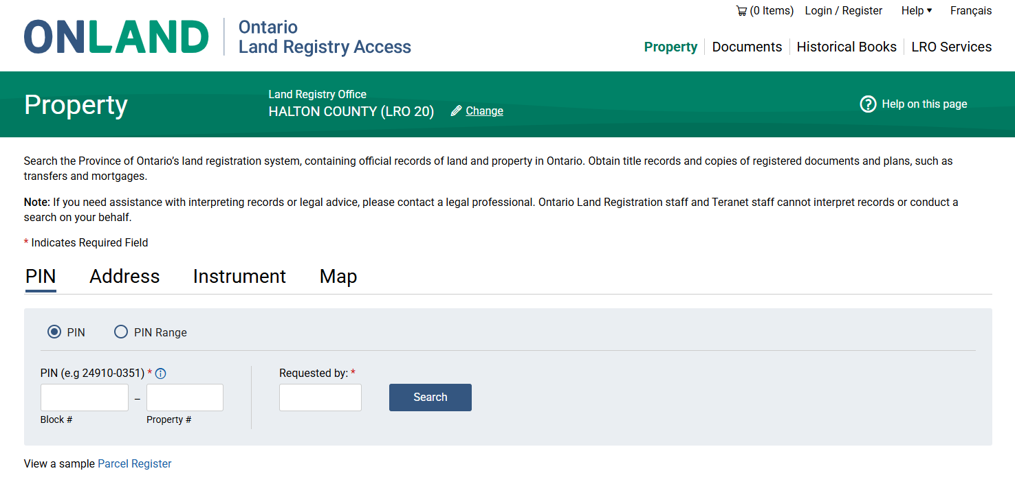
How to search
Select the correct Land Registry Office by typing in the name of your city
Select to search by “property”
Then, select to search by “address”

Slide 12
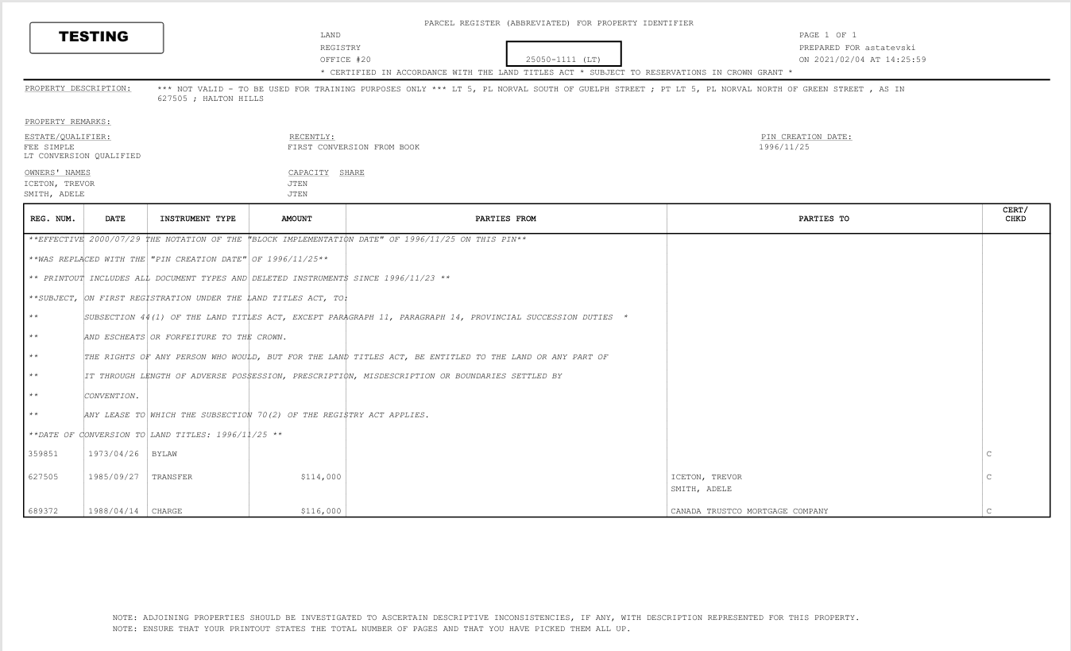
Sample Parcel Register

Slide 13
What if Someone who Purports to be the Owner/Landlord Requests that you pay Rent to them?
Seek independent legal advice: Find a Legal Clinic – Legal Aid Ontario
Confirm that they are the landlord
You should be hearing directly from the landlord initially, even if they have hired a Property Manager (as per the Notice sent to owners by SIREG, Schedule B to the Aide Memoire of the Proposal Trustee Microsoft Word - Aide Memoire of the Proposal Trustee dated October 13_ 2026(111992081.3)
If two entities are demanding rent, or if the rent is due before you are able to verify who the landlord is:
  Document your attempts to verify ownership and communicate clearly with both/all parties about those attempts
  Get rent receipts for any rent payments made. The landlord is required to provide these: s 109 of the Residential Tenancies Act
  If you miss a payment and you receive a Notice of Termination/N4, void the Notice by paying your rent in full to the landlord who issued the Notice within 7 days

Slide 14
Do I need to Enter into a New Lease with the Unit’s Owner?
No – your existing lease continues under the same terms and conditions. Only the landlord has changed.

Slide 15
Lease Renewals – s. 38
38 (1) If a tenancy agreement for a fixed term ends and has not been renewed or terminated, the landlord and tenant shall be deemed to have renewed it as a monthly tenancy agreement containing the same terms and conditions that are in the expired tenancy agreement and subject to any increases in rent charged in accordance with this Act. 2006, c. 17, s. 38 (1).
Fixed term tenancy is deemed to be renewed where a tenant has not given notice.
A tenant should not sign a new lease.
The tenancy becomes a month to month tenancy where usually 60 days notice must be given by the tenant to terminate.

Slide 16
Rent Increases
Once per year (with proper 90 day notice)
119 (1) A landlord who is lawfully entitled to increase the rent charged to a tenant for a rental unit may do so only if at least 12 months have elapsed,
(a) since the day of the last rent increase for that tenant in that rental unit, if there has been a previous increase; or
(b) since the day the rental unit was first rented to that tenant, if clause (a) does not apply. 2006, c. 17, s. 119 (1).
Your landlord must provide you with an N1 Notice 90 days prior to the increase taking effect:
116 (1) A landlord shall not increase the rent charged to a tenant for a rental unit without first giving the tenant at least 90 days written notice of the landlord’s intention to do so. 2006, c. 17, s. 116 (1).
Guideline increase
  2.1% for 2026
  Max of 2.5% set by legislation
Landlord must apply to the Board to increase rent above the guideline amount
Rent control exemptions
  Post - November 15, 2018 exemption
  Vacancy decontrol
  Agreements
Notes:
s.118 – deemed acceptance of NORI where no NOT
s.135.1 – increase that would be void due to lack of proper notice under s.16(4) is deemed not void if T paid increase for 12 consecutive months, unless T made application (T1) contesting validity of rent increase within the 12 month period
s.136(1) –rent deemed lawful unless application made within 1 year after first charged; (2) rent increase deemed lawful unless application made within 1 year after increase first charged
s.120(1) – can’t increase more than guideline except s126/127 or s121/123 (agreement for additional services (eg parking space) – O. Reg. 516/06 s16
Guideline based on the % change in the Consumer Price Index for the prices of goods and services
Proper notice needs to be in writing, set out details of rent and increase (etc) and provide 90 days notice – otherwise void
Interest on LMRD used to be 6%!
626114 Ontario Ltd. V Tirado, 200 CanLII 36461, [2005] O.J. No. 4350 (QL)
[…], the 1-year limitation in s. 144(4) [now s. 135 – money illegally collected] should not apply to interest payments under s. 118. Subsection 118(7) [now s. 106(9)] authorized a deduction of all interest owed.”

Slide 17
Other rules relating to rent
Landlord cannot require a tenant to provide post-dated cheques or agree to automatic debiting of their account
108 Neither a landlord nor a tenancy agreement shall require a tenant or prospective tenant to,
(a) provide post-dated cheques or other negotiable instruments for payment of rent; or
(b) permit automatic debiting of the tenant’s or prospective tenant’s account at a financial institution, automatic charging of a credit card or any other form of automatic payment for the payment of rent.
Landlord must provide a tenant with rent receipts free of charge if requested
109 (1) A landlord shall provide free of charge to a tenant or former tenant, on request, a receipt for the payment of any rent, rent deposit, arrears of rent or any other amount paid to the landlord. 2006, c. 17, s. 109 (1).
Notes:
s.105 = only security deposit is a rent deposit
s.111 (cited) = lawful rent
s.134 = no additional charges (O.Reg.516/06 s.17 exceptions)
s.108 = no requirement for post-dated cheques etc
s.109 = receipts
s.113 = new tenant under new tenancy agreement lawful rent is rent first charged

Slide 18
What can a tenant do if there are maintenance issues?
​Important to gather evidence of maintenance issues (i.e. pictures, emails, work orders, texts)
Send the new landlord a maintenance request (written) along with any previous requests made to the former landlord about the same issue(s)
Local property standards/by law department
File T6 application if the landlord does not respond, or if the response does not resolve the issue(s)

Slide 19
Maintaining common areas
If you reside in a condominium, the Condominium Corporation is responsible for maintaining common areas
If you have a concern with respect to common areas, make a maintenance request with your landlord
For immediate concerns, consider making the Administrator aware

Slide 20
Rights of Entry by Landlord
Entry with Notice:
24 hours written notice, with reason for entry
Allowable reasons:
  effect a repair
  show a prospective purchaser, mortgagee, insurer
  To satisfy a requirement imposed under Condominium Act
  Inspect if determining whether or not the rental unit is in a good state of repair and fit for habitation and complies with health, safety, housing and maintenance standards, and it is reasonable to carry out inspection
Entry without notice:
  Emergency
  tenant consent
  to clean, where provided for in tenancy agreement
  to show prospective tenants where a notice of termination or agreement to terminate exists
See RTA s. 26, 27
Notes:
Inspection issue: this can be hard on tenants suffering from mental health issues.
Issue of notice = difficult (e.g. lld gives tenant notice that is unfounded)
LL must make a “reasonable effort to advise tenant of intent to enter; between 8-8

Slide 21
Overview of Tenant Responsibilities
Pay rent in full and on time
Maintain ordinary cleanliness of unit
Do not interfere with others
No undue damage
Give lawful notice of termination

Slide 22
Overview of Landlord Responsibilities
Maintain the complex and units in a good state of repair and “fit for habitation”
No interference with services
No interference with tenants’ use and enjoyment of the property, no harassment, interference, reprisal or coercion
Respect tenants’ right to privacy
Human Rights Code applies to the Residential Tenancies Act
No changing the locks

Slide 23
Community Legal Aid Clinics:
Key objectives:
  Legal advice and representation
  Public Legal Education
  Law Reform
Eligibility of services is based on income, but we will give referrals to better suit your needs!
General Legal Advice available to all local residents
Notes:
71 legal clinics, geographically based and specialty clinics run by volunteer board of directors that reflect the needs of the community
Financial Eligibility
Community Legal Clinics serve low income people. If your income is too high, we cannot assist you, but we will do our best to refer you somewhere else.

Slide 24
Resources and when to use them
Rental Housing Enforcement Unit ​
  Offences by landlord, such as illegal lockout, harassment, withholding vital services ​
Community Legal Clinics ​
  Provides legal advice and representation on housing matters
  Search based on postal code​
Tenant Duty Counsel ​
  Free legal advice if tenants on or just before your hearing from the Landlord Tenant Board​
Pro Bono Ontario​
  Up to 30 minutes of free legal information and advice
Notes:
https://www.acto.ca/production/wp-content/uploads/2023/05/HousingHardship_ACTO_June_2023.pdf

Slide 25
Resources and when to use them
Law Society Referral Service: findlegalhelp.ca ​
  Up to 30 minutes of free legal information and advice​
Human Rights Legal Support Centre and/or Canadian Centre for Housing Rights ​
  Advice and help for a discrimination complaint ​
General legal information:​
  Landlord and Tenant Board
  Community Legal Education Ontario (CLEO)
  Steps to Justice
  ACTO’s web-based resources
Rent Bank and HSF for OW/ODSP (region-dependent)

Slide 26
Resources for SIREG bankruptcy proceedings
Simple Investor Real Estate Group Inc., SIREG Management Inc., SIREG Holdings Inc. and certain related entities

Slide 27

Thanks!
Any questions?

