Slide 1

ACORN Canada
Protect our Homes!
Saturday February 7th, 2026

Slide 2
Welcome
Land acknowledgment
Introductions
  Facilitators
Ground rules for zoom
Review of the agenda
  What is ACORN?
  Provincial Updates (3 - 4) min each
  What is happening with Build Canada Homes & ACORN’s Demands
  Start calling politicians!
  COnvention

Slide 3
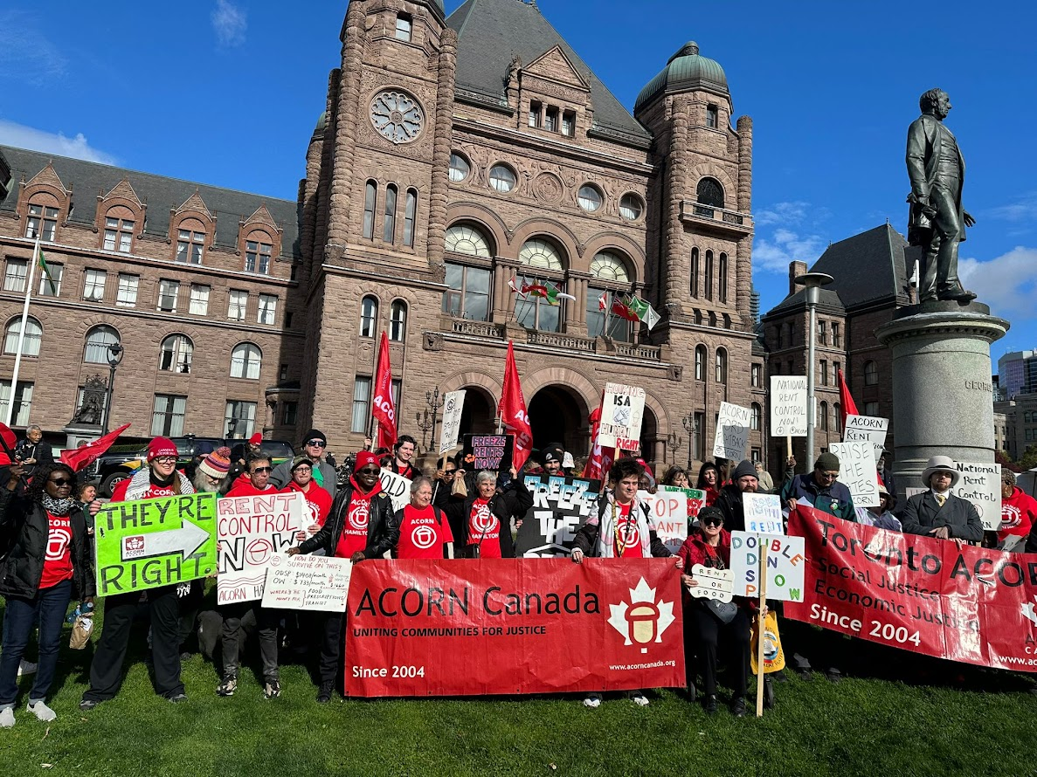
What is ACORN?
ACORN Canada is a multi-issue, membership-based community and tenant union of low- and moderate-income people. We believe that social and economic justice can best be achieved by building community power for change.

Slide 4
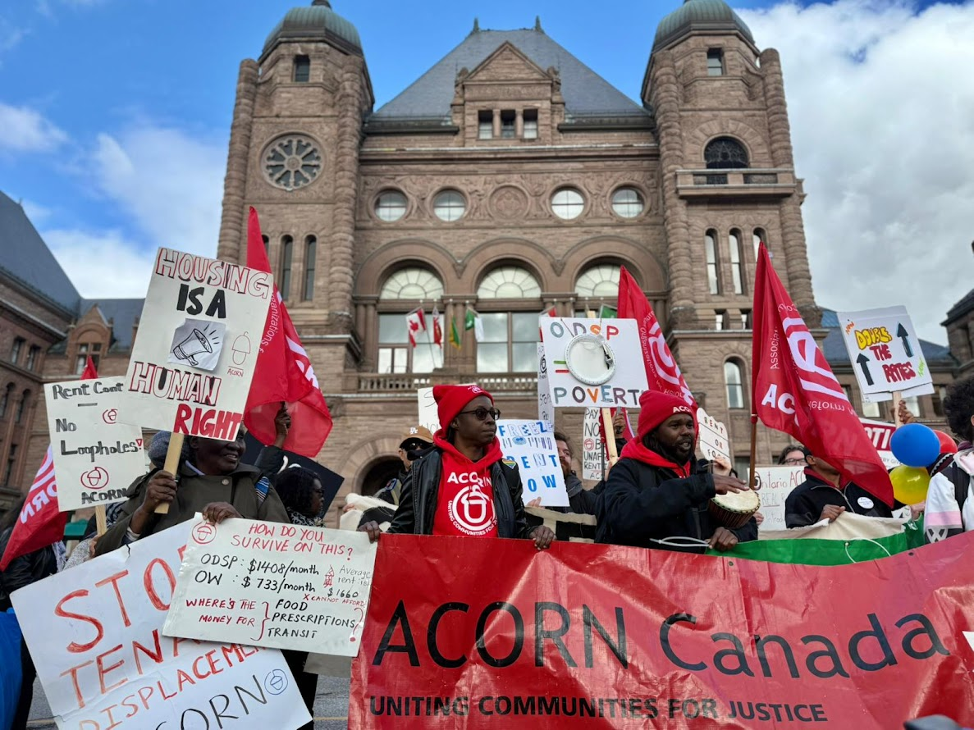
What is ACORN?
Our members fight landlords and corporations through direct action. Our members also fight for new and improved laws to protect their rights. Each member has a vote, and only members speak for the organization and have the authority to set the policy and determine the tactics of each group.

Slide 5
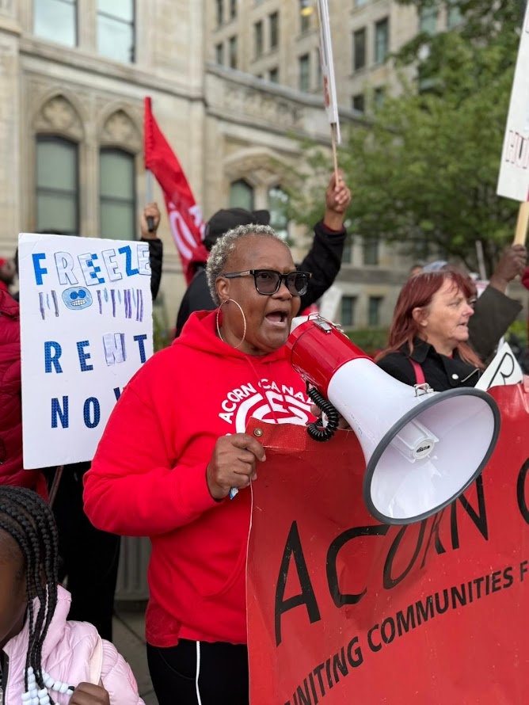
What is ACORN?
We have 190,000+ members in 30 neighbourhood chapters in 10 regions across 6 provinces.
Like any union, our members pay dues so that they can have ownership and control over the direction of their organization. This makes us sustainable and independent from corporations, banks and governments that fund most non-profits.

Slide 6
BC ACORN - (Monica Bhandari)
Rent control exists, but loopholes persist!
BC NDP Government has done some good things:
Province-Wide Renoviction Ban
Landlord Use Eviction Ban
Whack-a-mole - close a loophole, another appears
Tenant Harassment
  Offered large sums of money to move
  No repairs for long term tenants
  Verbal abuse
Transit Oriented Development and Demovictions
  Tenants in cities without anti-tenant displacement protections at HIGH RISK of demoviction:
    Surrey, Coquitlam, Langley, Maple Ridge, Port Coquitlam….

Slide 7
BC ACORN
We say “Keep Tenant Communities Intact”
Province-Wide anti-tenant displacement laws
Anti-Tenant Harassment Legislation
BC needs to be a leader in tenant protections, can we get the federal governments help in making that happen?

Slide 8
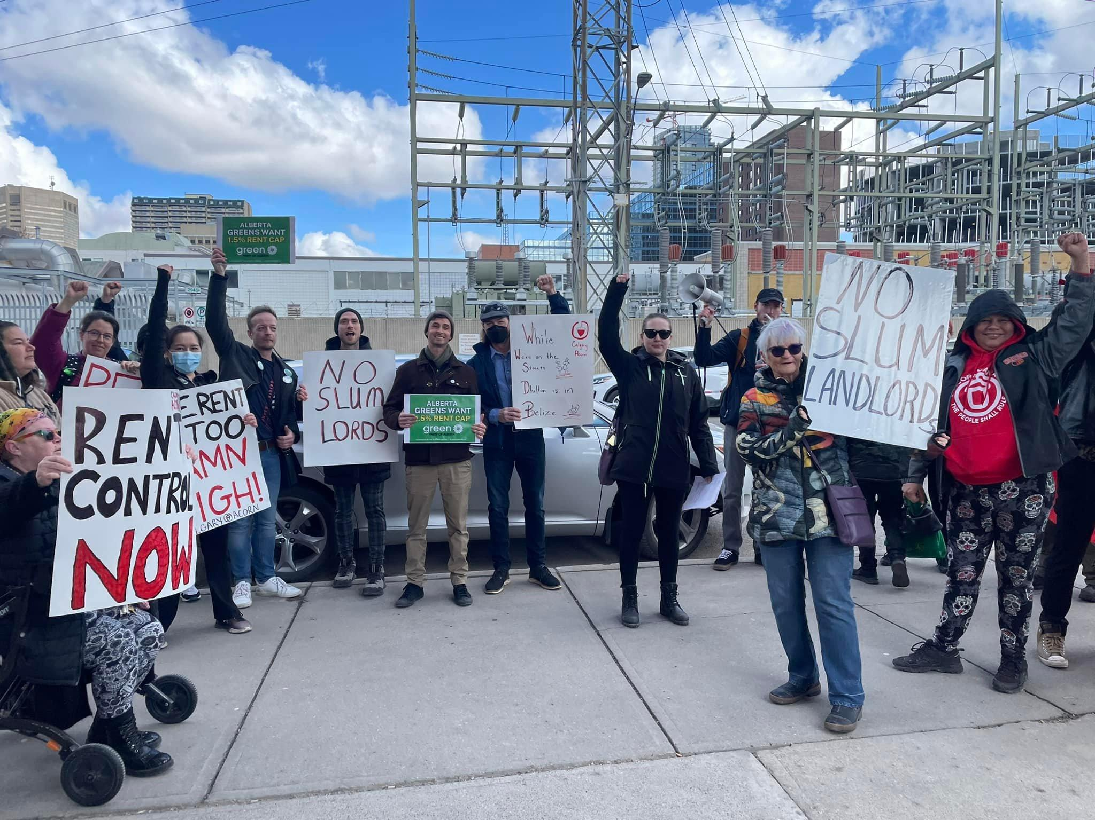
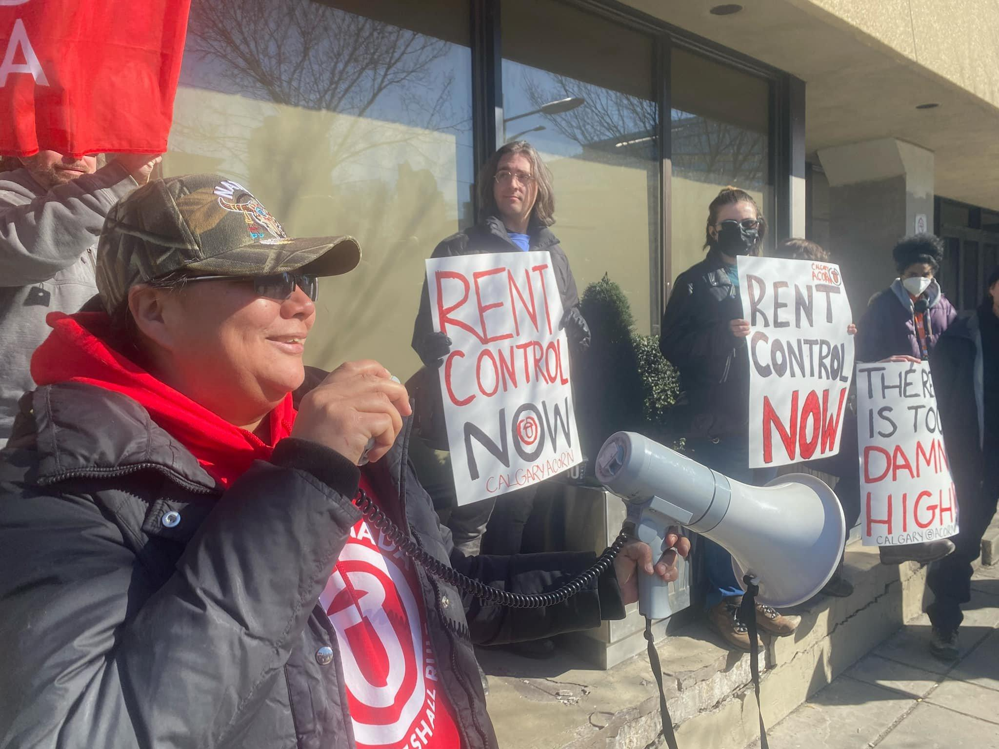
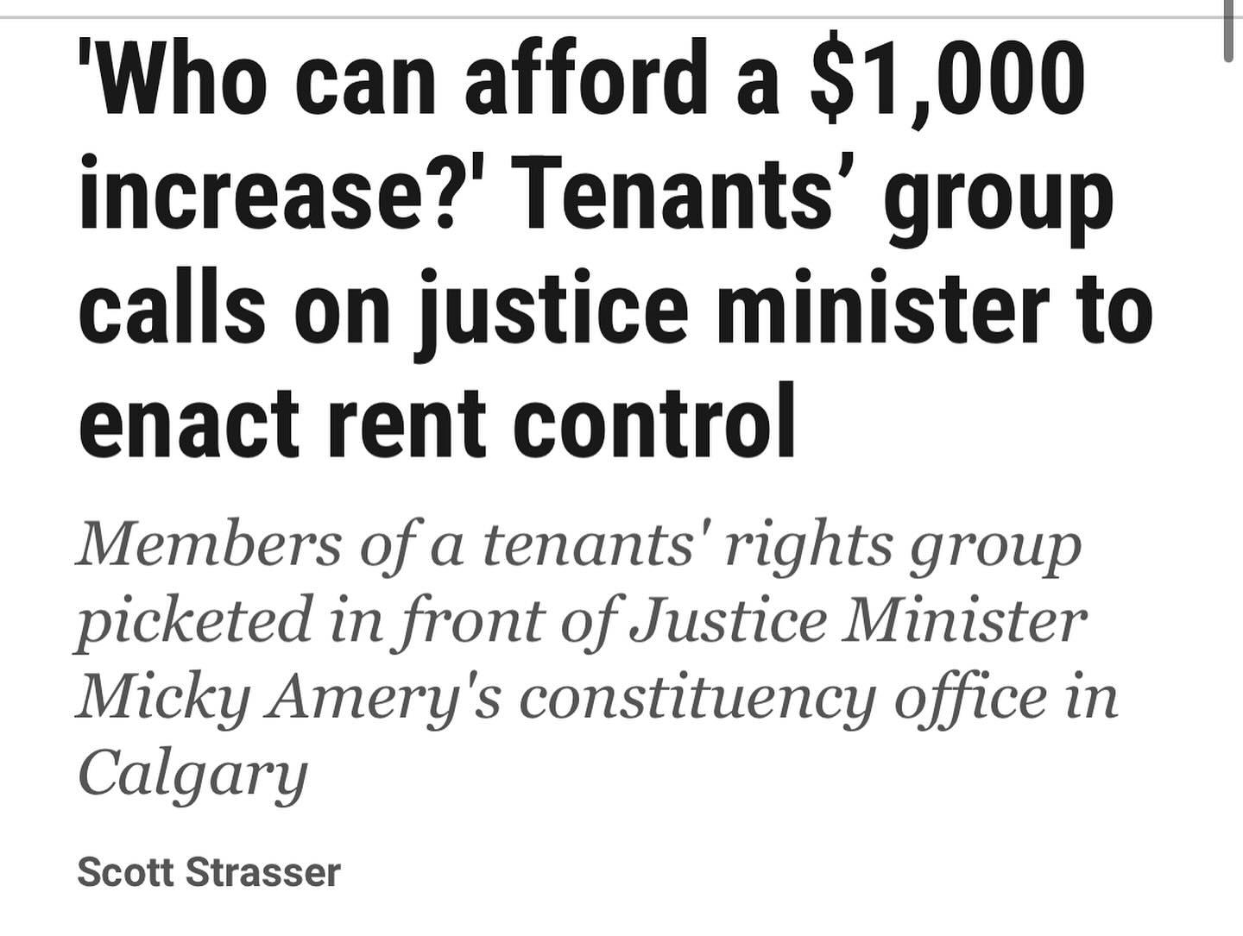
Alberta ACORN - (Elaine Bruce-Haynes)
Context: Alberta has almost NO tenant rights.
NO rent control
meaning NO limits to yearly rent increases.
Since 2023 rents in Calgary rose over 30% across the board.
Fixed term lease system
meaning NO security of tenure
Fixed term lease VS Month-to-month lease
Landlords are not required to offer a current tenant a lease renewal. Nor do they have to provide any justification for non renewal of lease.

Slide 9
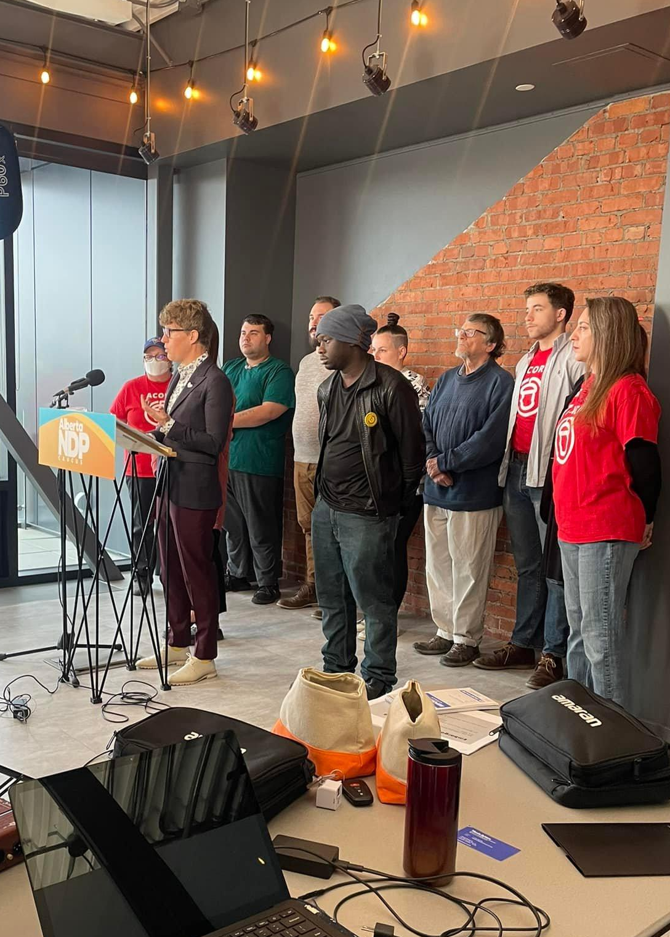

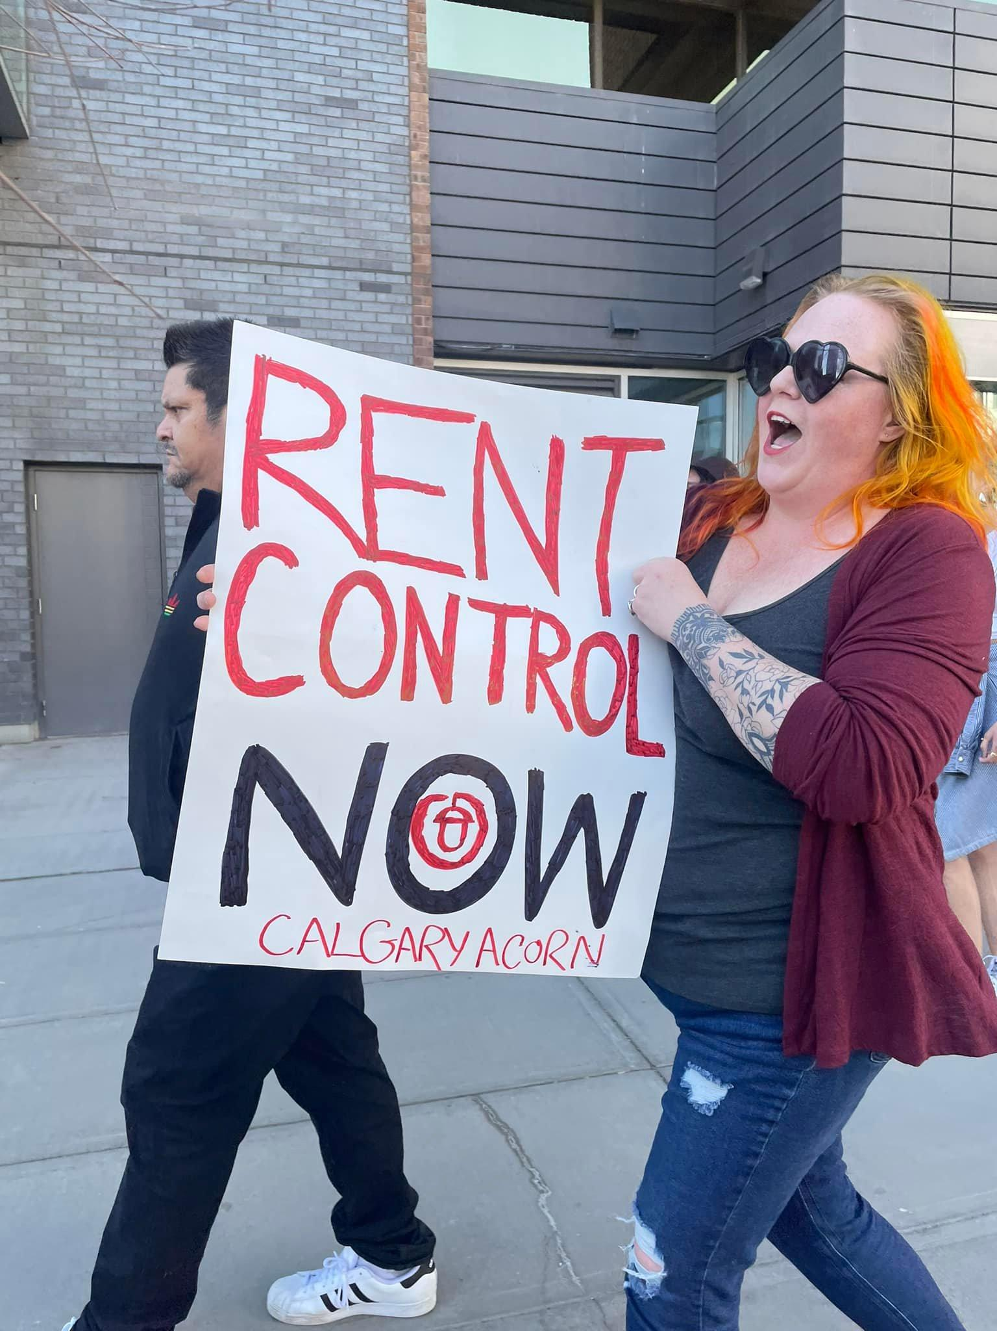

Alberta ACORN
Alberta ACORN’s Provincial Housing Campaigns:
Rent Control NOW
  A simple rent cap would be a major step for Alberta
Ban Fixed Term Leases
  Standardized leases across the province that allow fixed term leases to roll over to month to month after a 1 year period (like Ontario)
Alberta Provincial Government: A Brick Wall
Marches, Rallies, Media, Online actions, Pickets of MLAs
Movement with the Alberta NDP
ACORN pushed the NDP to come out with Bill 205 for a temporary rent cap
Voted down by UCP but still created major movement!
New AB NDP leader met with ACORN and voiced support for both a rent cap and banning fixed term leases
Summary of Problem:

Slide 10

Ontario ACORN (Tanya Burkart)
Context: In Ontario we have rent control but it is weak/partial
ACORN’s DEMANDS:
FULL Rent Control
Close rent control loopholes (apply to all buildings and vacant units)
Ban Above Guideline Increases (AGIs)
Highlights:
26,000+ emails sent telling Ford to keep hands off rent control! Housing Minister walks back announcement to bring in fixed term leases.
Winning decreases in AGIs in our members’ buildings
Set the precedent that buildings with the same landlord in different cities can have their N13 (renoviction) hearings grouped together
Michael Klein (Ontario’s biggest renovictor) dropped all N13s in remaining buildings

Slide 11
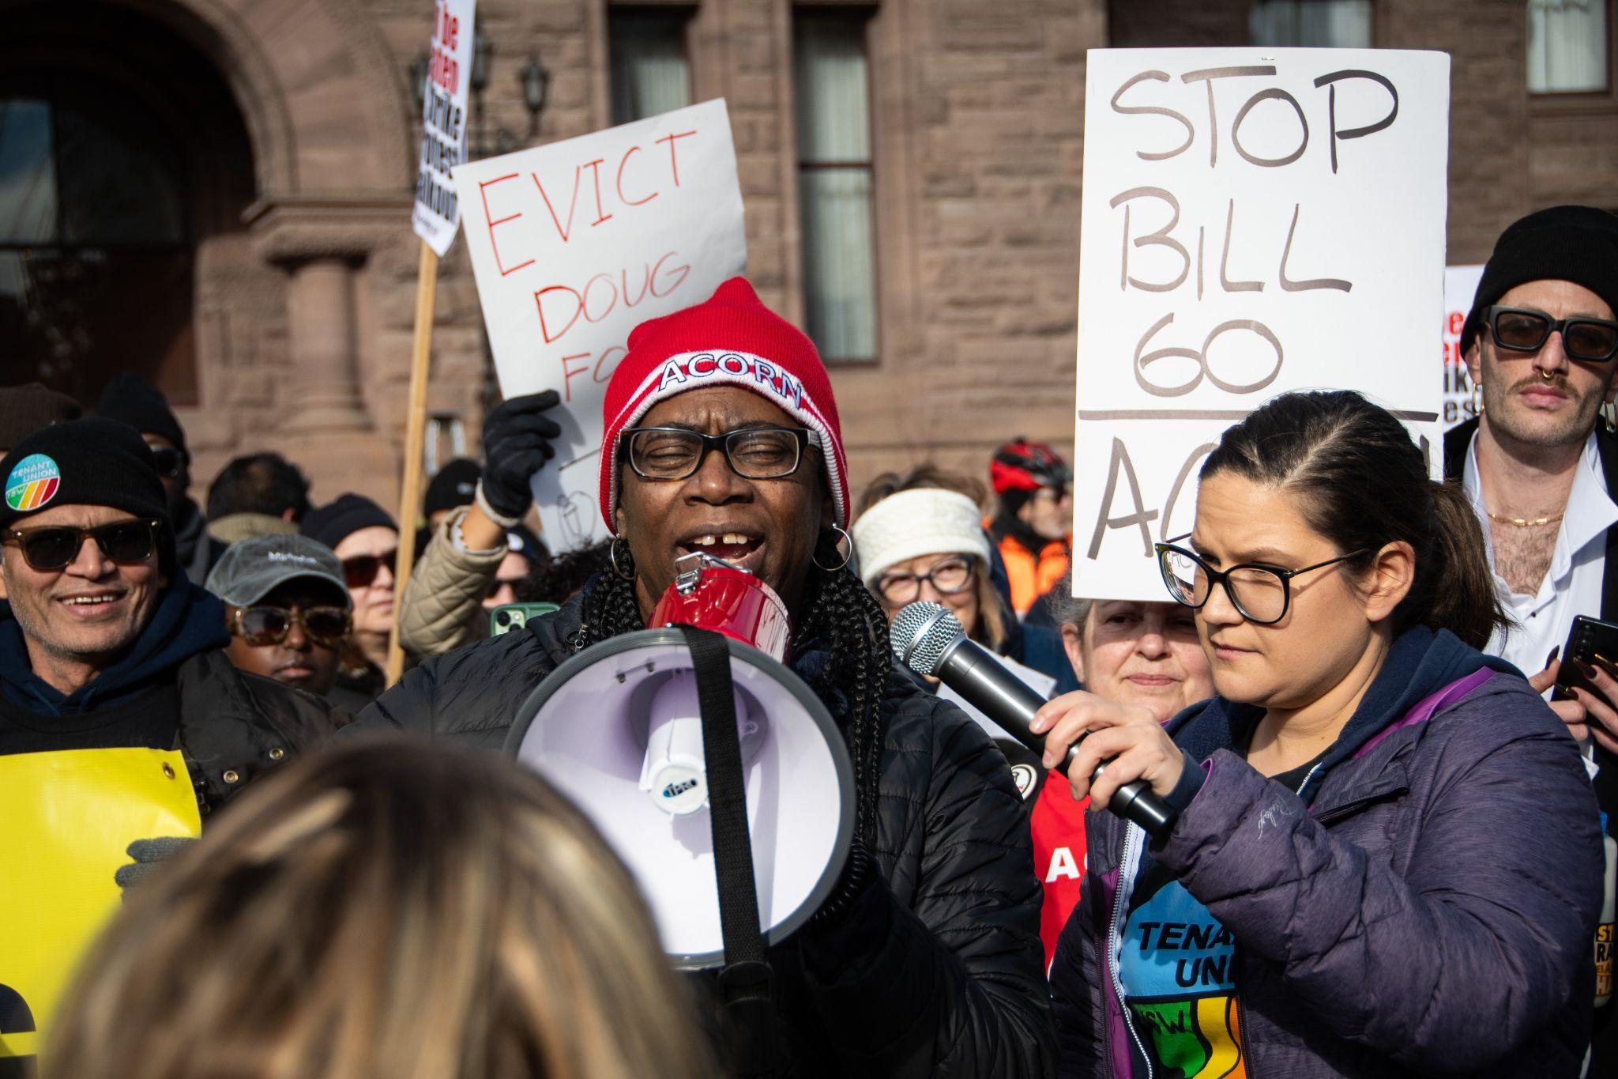
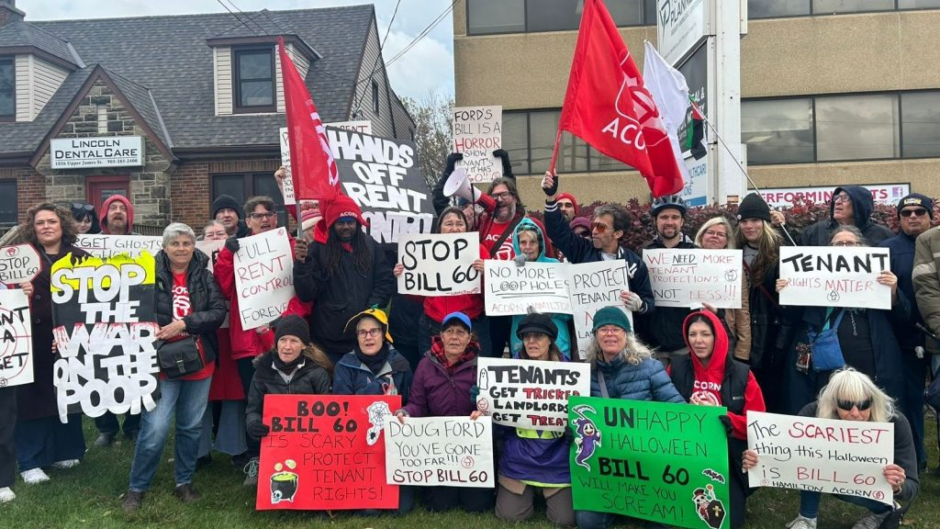
Ontario ACORN
Bill 60 & Provincial Rent Grant Program
Bill 60 speeds up evictions which will lead to more homelessness. A rent grant will keep tenants housed in emergencies.
Highlights:
500+ zoom meeting
Multiple days of actions and SO much press!
1000+ march to Queens Park on national housing day
ACORN disrupts the legislature, covered by New York Times
Summary of Problem:

Slide 12
NB ACORN (Nichola Taylor)
We won rent control, and security of tenure - but need rent control done right!
• Renoviction: Evictions for non-essential renovations, rarely necessary.
• Landlord-use: Evictions for landlord/family occupancy, sometimes abused in larger buildings.
• Cash-for-keys: Tenants pressured to leave for money, face higher rents.
• Fixed-term leases: End dates remove security, enable displacement.
• Harassment: Neglect, threats, inspections, and frivolous evictions to force tenants out.

Slide 13
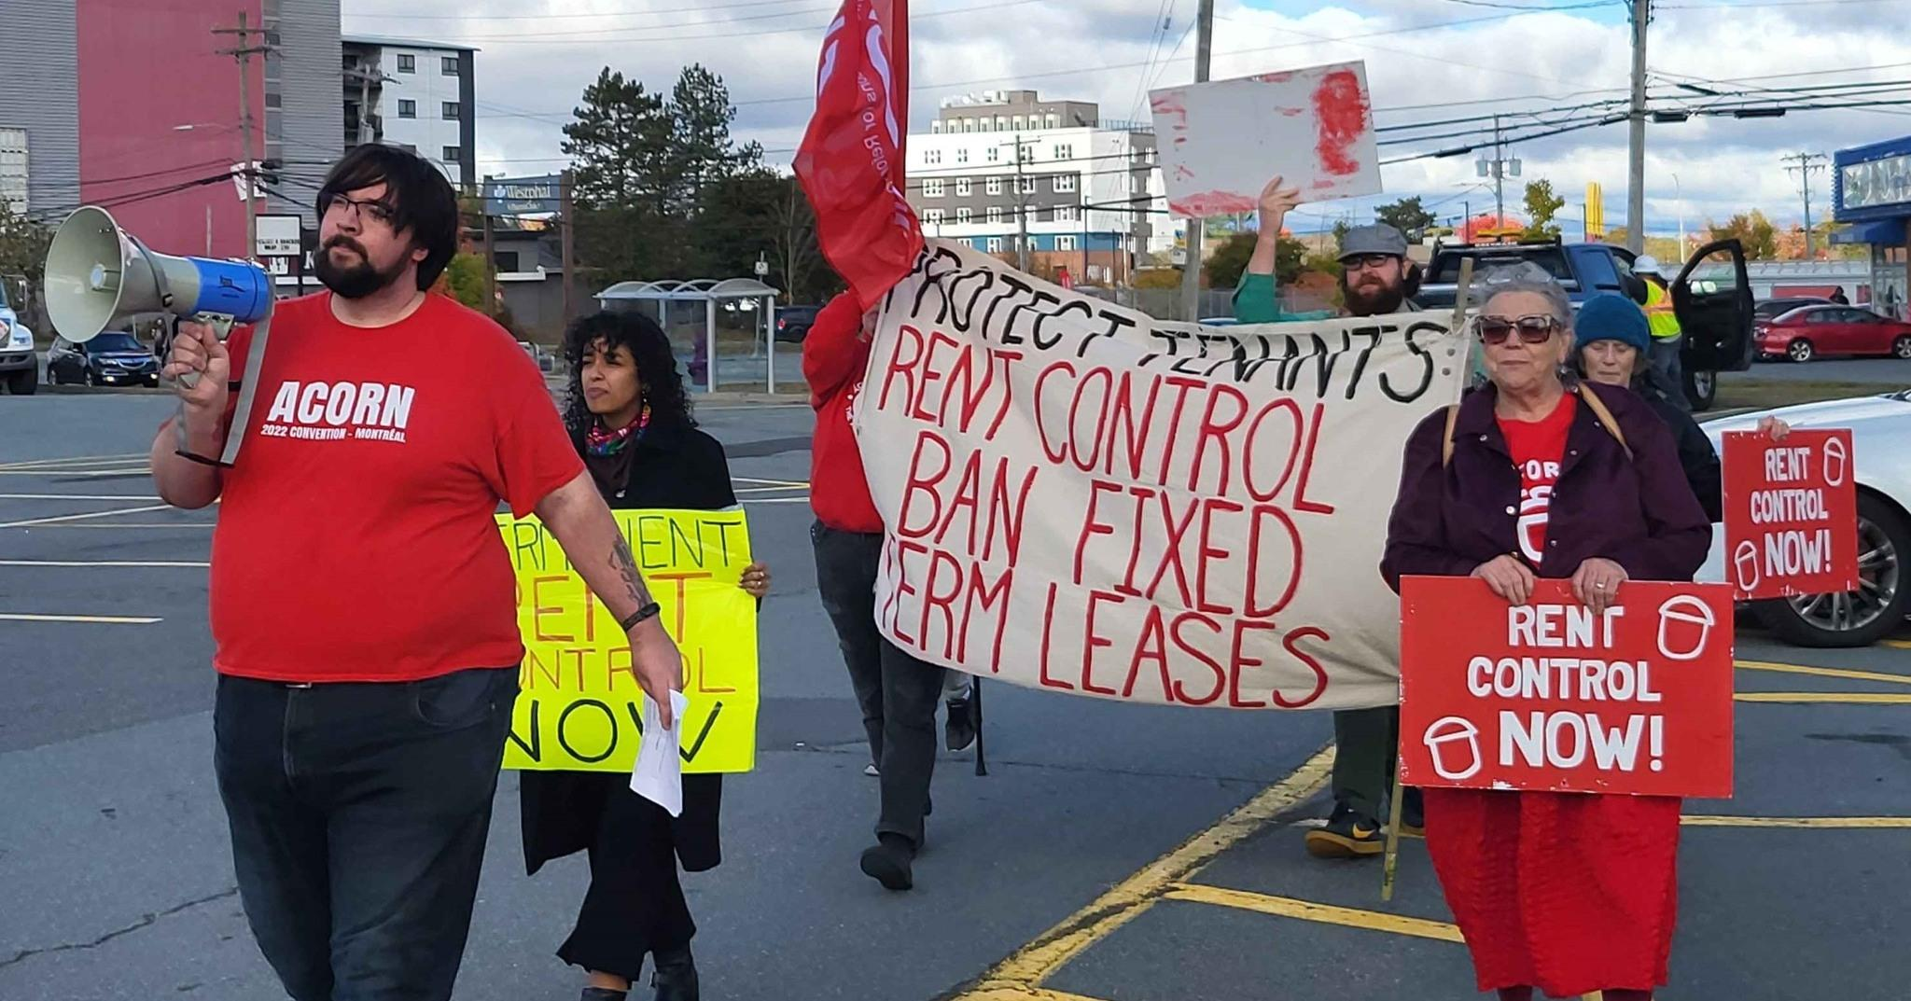
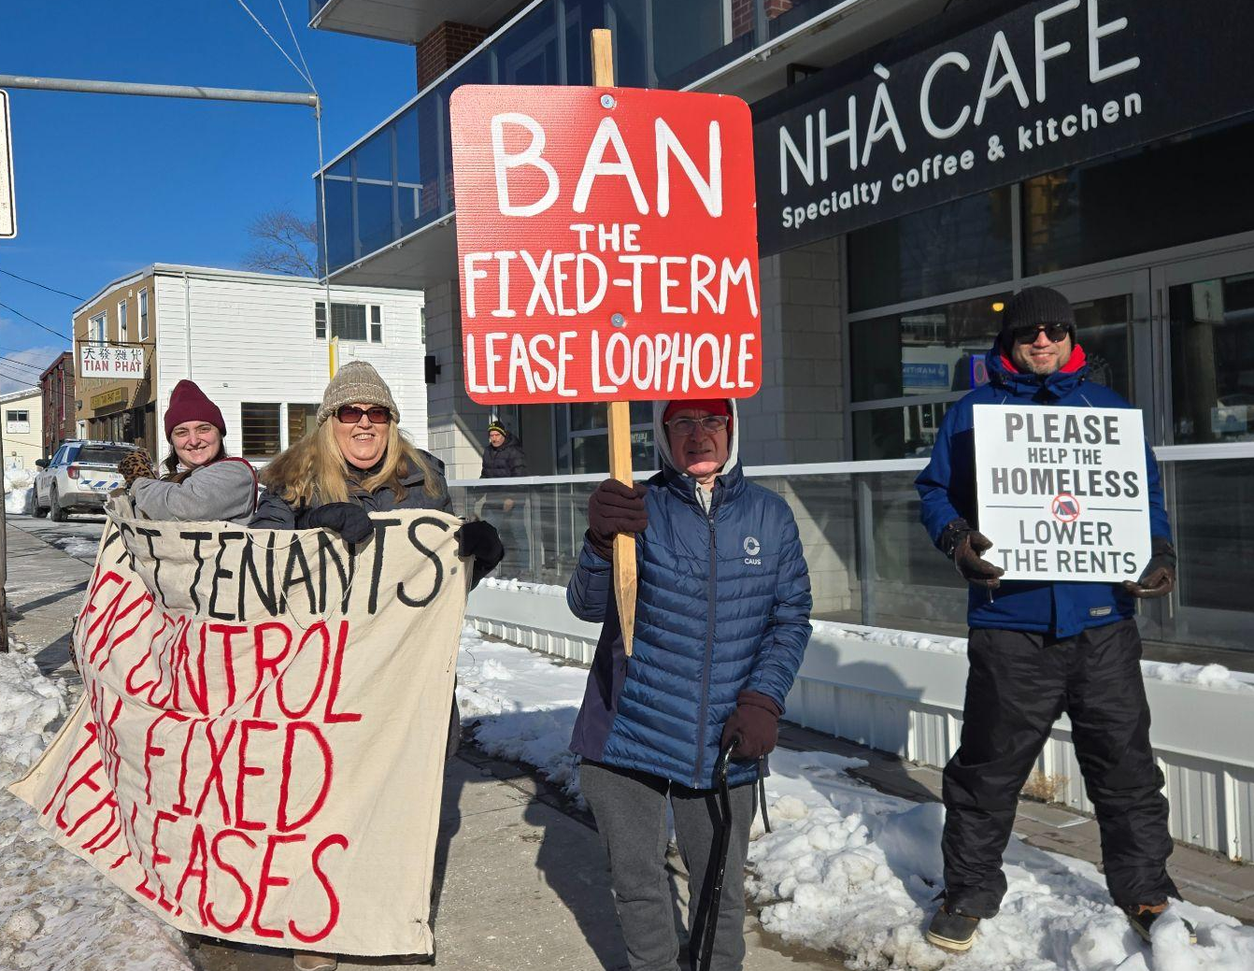

Nova Scotia ACORN (Darryl King)
WON rent control - 5% rent cap, but big loopholes still exist
Fixed term leases - forces tenants to sign new lease every year/at end of each term
  Used by landlords to work around rent cap - tenants kicked out with no hearing, no due process, or coerced into massive rent increases
  ACORN’s report found over 35% of tenants on a FTL have been evicted on a FTL before - SHAME!
Rent cap only temporary - set to expire in 2027
Renovictions and landlord-use evictions
Nova Scotia ACORN is demanding the province:
BAN all fixed term leases
Make rent control permanent
Build robust rules around rent control to stop other loopholes like renovictions and landlord-use evictions

Slide 14
Federal Government & Housing (Nichola Taylor)
ACORN has demanded that the federal government:
Build affordable non market housing and Protect existing affordable housing
Specifically:
Champion the protection of affordable housing with federal leadership!
HOW?
Leverage federal housing funding to require provinces/municipalities to meet tenant protection standards.
Push for the Renters’ Bill of Rights to include:
  Real rent control, no loopholes.
  Bans on no-fault evictions and end fixed-term lease abuse.
  Secure tenure for all renters.
Ensure Build Canada Homes funding prioritizes adequate, non-market housing for tenants in core housing need.

Slide 15
What is Build Canada Homes?
It's a new federal agency set up to build housing (mostly non market they say)
Federal Government announced in the fall they were investing $13 BILLION to this NEW agency
Building rental housing and deeply affordable rental housing is obvious desperately needed.
BUT its only ½ the solution. The government also needs to Protect the EXISTING affordable housing. Where many of us we all live right now!
Recent analysis by the federal budgetary office (PBO) shows that the estimated number of units being built in the next 5 years not a big as they hoped.
The PBO provides independent, non-partisan financial and economic analysis to assist government bodies in scrutinizing public spending.

Slide 16
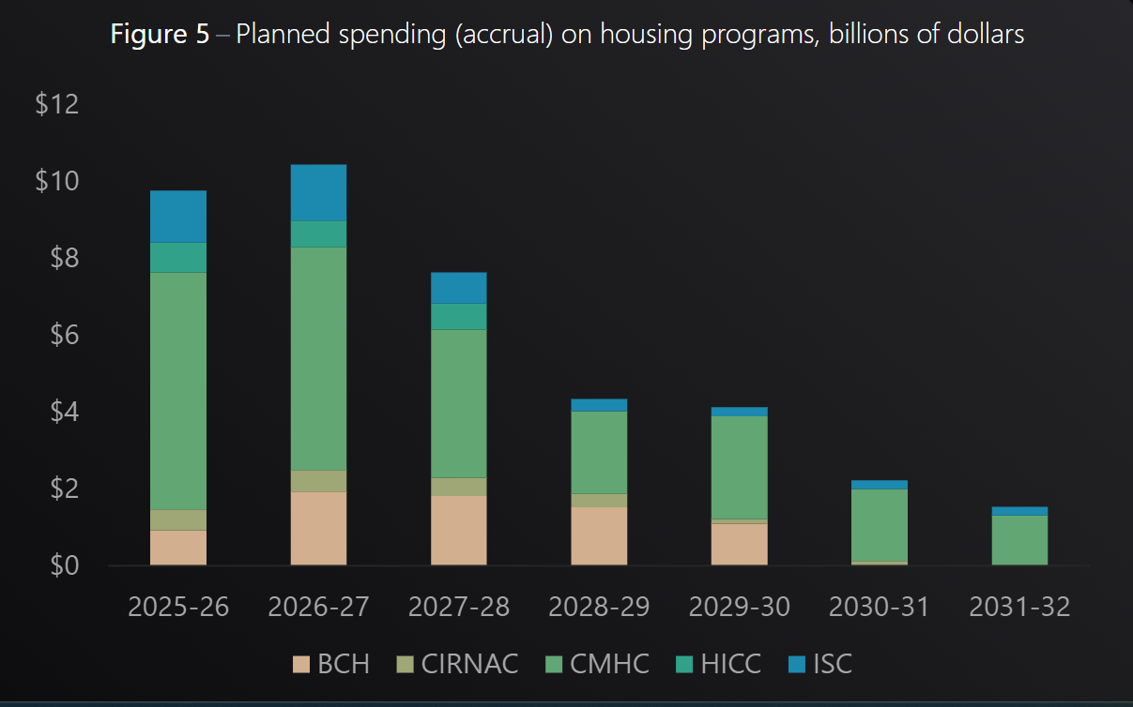
Federal Housing Spending Over Next 5 Years
Notes:
From the Office of the federal parliamentary budget office Dec 2025

Slide 17
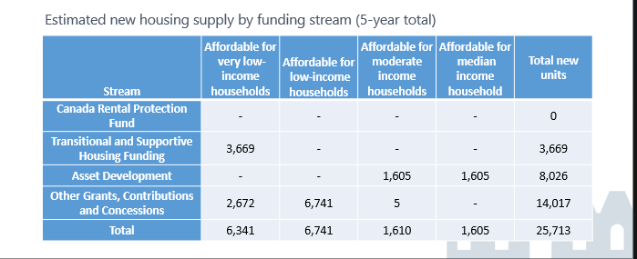
Estimated 26,000 new units. 13,000 for lower income folks
Notes:
https://www.pbo-dpb.ca/en/publications/RP-2526-020-S--build-canada-homes-outlook-housing-programs-under-budget-2025--maisons-canada-perspectives-entourant-programmes-logement-dans-cadre-budget-2025

Slide 18
HOW much housing do we lose every year?
We are losing affordable rentals faster than we are building them:
  Between 2016–2021, Canada lost 230,000 affordable rental units (CHEC, 2022)
  That is 46,000/ year
Canada’s total non market housing stock is (3.5%) shamefully low when compared to other OECD (expenad ) countries (6.9%).
Why?:
  Weak or absent rent control laws.
  No protection against no-fault evictions or non-renewal of leases.
  Fix Term Leases allow landlords to end leases at will.
  Financialized landlords targeting entire communities with rent hikes.

Slide 19
What is the Federal Government Doing to Protect Affordable housing ?
In September the Federal Government Announced
$13 billion, to Build Canada Homes
Ana Bailão as the Chief Executive Officer of Build Canada Homes
protect existing affordable rental housing,: the $1.5 billion Canada Rental Protection Fund
What else can they DO?
LOTS - structure housing funding like Healthcare and childcare where standards are tied to federal money.
As we heard earlier, the provinces regulate a lot of provincial standards BUT the federal government gives money
They can require the provinces to have a minimum standards like Rent Control no loopholes

Slide 20
All Federal Money needs to require provinces to
  Real rent control, no loopholes.
  Bans on no-fault evictions and end fixed-term lease abuse.
  Secure tenure for all renters.

Slide 21
Fun Brainstorm Exercise: What do People Think ? (Stacey Semple)
  Brainstorm How to we explain to PM Carney and Minister Robertson. That they are planning to build 2600 affordable units per AND 5000 units / year BUT we are losing like 46,000 per year.
  BUILDING can’t be the only solution
WHAT are ways we can describe this to the gov.?
  Filling a bucket with holes with water ???
  Put in the chat other analogies

Slide 22
Let's do a Phone Zap
  Who are we calling? HOusing Minister Gregor Robertson; PM Carney; Assistance Housing Minister McKelvie
  Goal is to flood their phone lines
  Even if you get a voicemail that’s okay - someone needs to check those!
  We will go over the phone script in a minute.
  If you can, do your phone calls while on speaker phone. If you connect to a live person, we will try to UNmute you
  With so many on the zoom it might get a little messy but that’s okay! We’re going to try our best!
Reminders:
  Do the calls on speaker phone
  Let us know how the calls are going in the chat
  Let’s get started!!!
Stacey (ME) will now do a demo call !!

Slide 23
Phone Zap Targets and rap
Calls
Housing MInister Gregor Robinson
613-995-7052 - Hill Office (V N-y)
343-644-9948 - ministry office
236-203-2211 - Constituency Office (Vancouver)
343-644-9948 - Marie-Pascale Des Rosiers, Chief of Staff
PM Mark Carney
Fax: 613-947-9370 - PM office
613-825-3422 - Constituency office Nepean
Jennifer McKelvie :
Klander, Charrissa; 905-426-8099; Chief of Staff;
McKelvie, Jennifer; 613-995-8042;
Example MESSAGE: “Hi my name is ________ and I’m an ACORN member. We see that the federal government plans to build 2600 - 5000 affordable rentals per year . BUT UNFORTUNATELY we are losing about 40- 46 THOUSAND per year. We need to protect EXISTING affordable housing by having minimum rental standards tied to federal money, like health care! Please meet with ACORN to discuss this 416 461 5322 or email canadaacorn@acorncanada.org.
IF THEY ANSWER
Hi, i'm ____ from ACORN and we would love to meet with Minister Robertson/ PM Carney / Hon MP McKelvie … We urgently need to meet to discuss how the federal government can help protect affordable housing. You have committed to build 5000/ year but we are losing 46,000 per year. Please meet with ACORN to discuss this 416 461 5322 or email canadaacorn@acorncanada.org.
Notes:
Get stat how much housing we need. - Over 235,000 people face homelessness

Slide 24
Convention (Marva Burnett)
https://acorncanada.org/video/acorn-national-convention-2024/
https://acorncanada.org/convention-2019-video/

