Slide 1
Know Your Rights: Above-Guideline-Increases
Name | Date

Slide 3
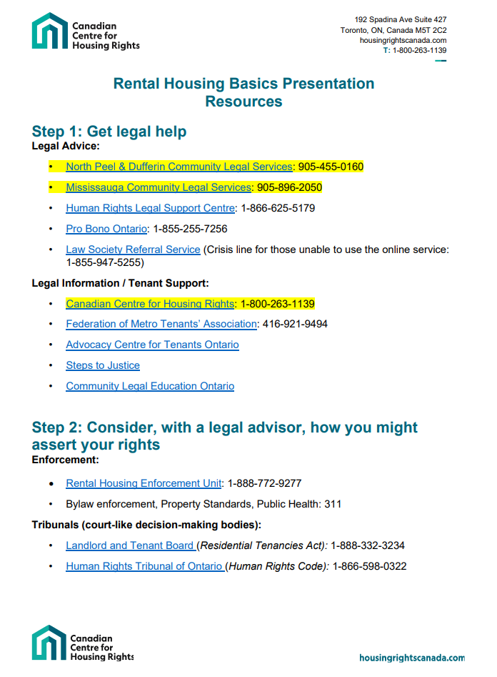
Get Help First
Laws
Residential Tenancies Act*
Human Rights Code*
Fire Code
Building Code

Slide 4
Rent Increases

Slide 5
Rent increases (RTA sections 116, 119, 120)
90 days’ notice
Landlords have to give you notice on an official form.
If they don’t give you proper notice, the rent increase is void and they have to give you a new notice.
12 month rule
There has to be at least a 12-month gap between rent increases. RTA section 119(1).
Guideline amount
Landlords of older, market-rent units can’t increase the rent by more than the guideline amount (2.5%).

Slide 6
Rent increases: agreements (RTA sections 121, 122)
A landlord and tenant can agree to increase the rent if:
The landlord will carry out a specific capital expenditure in exchange for the rent increase,
The landlord will provide a new or additional service for the rent increase, or
The landlord will add a parking space or other privilege.
A tenant should get legal advice before signing an agreement.
If a tenant has already signed an agreement they should still get legal advice.
A tenant can complain to the Landlord and Tenant Board if the landlord does not live up to their side of the deal – but there are time limits.

Slide 7
Rent increases: AGIs (RTA section 126)
Landlords can apply for AGIs if:
There is an “extraordinary increase” in municipal taxes;
There are “capital expenditures”; or
There are security costs.

Slide 8
Rent increases: AGIs (RTA section 126)
Landlords must provide paperwork to prove that one of these applies and must share it with the tenants electronically or in-person.
Landlords have special notice requirements for elevator repairs.
Landlords cannot charge the AGI rent until the Landlord and Tenant Board issues an order. If tenants pay the higher amount and then the LTB refuses to grant the AGI, the landlord has to pay the extra money back to the tenant.

Slide 9
Extraordinary municipal taxes/charges
Charges are “extraordinary” if they are the guideline amount plus 50% (For example: 2.5% + 1.25% = 3.75% increase)
They include municipal taxes (including education taxes) and charges, but do not include:
Charges for municipal inspections
Charges for municipal emergency repairs
Charges from the municipality for landlord’s non-compliance with their orders
Municipal penalties, late payment fees, fines

Slide 10
Capital expenditures
“Capital expenditures” are repairs necessary to:
Protect or restore the physical integrity of the building;
Keep the building in a good state of repair and fit for habitation and for complying with health, safety, housing and maintenance standards;
Maintain plumbing, heating, mechanical, electrical, ventilation, A/C systems;
Provide access for people with disabilities;
Promote energy or water conservation; or
Maintain or improve security.

Slide 11
Capital expenditures
“Capital expenditures” should have a benefit that will extend for at least five years.
They do not include payment for work taken on by a municipality or public utility because the landlord failed to do it.
They do not include “routine or ordinary work” to keep things operating.
They do not include cosmetic work.

Slide 12
Capital expenditures
Landlords have to show proof of their expenses, but also any grants and assistance that they would get from government, insurance, resale, salvage and trade-in of old parts.
Landlords have to show details for each invoice and payment of each repair item.
Landlords have to show details about the rents for all rental units that are affected.

Slide 13
Capital expenditures
Landlords must subtract grants, etc, from the amount they pass on to tenants through an AGI.
Landlords cannot pass on charges for fines, late payments, etc.
Landlords cannot pass on costs from amounts they’ve already received an AGI in the past.
Landlords cannot pass on costs that are above market value. (Non-arms’ length transactions.)

Slide 14
Capital expenditures
A landlord may not be able to claim something is a capital expenditure if the system they’re replacing didn’t need major repair/replacement, but there are exceptions if the repair promotes access, conservation or security.

Slide 15
Capital expenditures
A landlord can’t charge a new tenant for “capital expenditure” repairs that were completed before they arrived.

Slide 16
Capital expenditures
Landlords can assign capital expenditures differently to different parts of a complex, depending upon where the repairs are done.

Slide 17
Security costs
Landlords have to show evidence of their costs, and their payment of those costs in the “base year” and a “reference year”.

Slide 18
The AGI Process

Slide 19
The AGI Process
Landlord provides notice to tenant
Landlord files L5 application
Landlord and Tenant Board schedules a hearing
Case Management Hearing
Merits Hearing

Slide 20
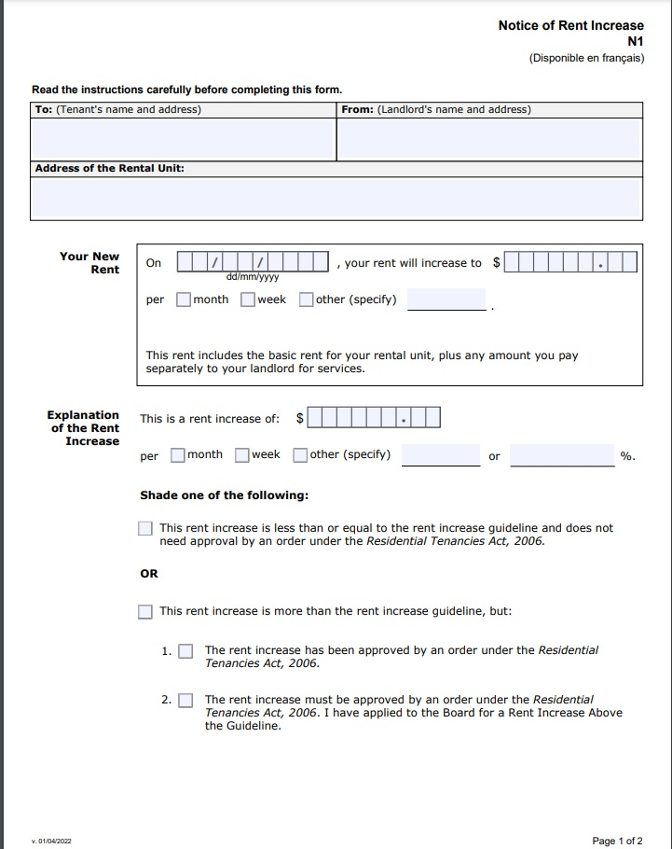
Notice
Landlord must give N1 Notice of Rent Increase to the tenant
Landlord must give the tenant the Notice at least 90 days before the date they want to increase the tenant’s rent.
If the dates are wrong, you can argue that the Notice is defective, and the Notice should be thrown out
The Notice of Rent Increase should indicate the increased rent amount
The tenant does not have to pay this higher amount unless it is approved, and an order is issued by the Landlord and Tenant Board.

Slide 21
Landlord files L5 Application
If tenant doesn’t pay the AGI amount noted on the Notice form, the Landlord can take the matter to the Landlord and Tenant Board, for them to make a decision.
The Landlord must file an L5 application with supporting documentation
The L5 application, and the supporting documentation, must be provided to tenants whose units are affected at least 30 days before the hearing date.

Slide 22
The LTB schedules a hearing
Recently, the LTB schedules a Case Management hearing before a Merits Hearing for AGIs.
Case Management Hearing: in the AGI context, it is often a mediation session to facilitate a resolution between the landlord and tenant. A Dispute Resolution Officer is often present and they will assist with mediating an agreement between both sides
Merits Hearing: both sides make arguments as to the merits of the application. With a merits hearing an adjudicator will make the final decision on whether to grant the above guideline increase

Slide 23
Preparing for a CMH
Determine if you would like to negotiate a settlement
Determine how much you are willing to accept
Other Relevant considerations include: how long you will need to pay back the amount if granted, if you have not paid it.
Call CCHR or your local community legal clinic for advice on the process

Slide 24
Challenging AGI
Keep copies of all documents, take photos of posters, etc.
Review landlord’s documentation
Look for issues such as:
Whether the landlord did their paperwork properly. Did you get 90 days’ notice? Did they fill everything out?
Whether the renovations fall into the categories of extraordinary tax increase, capital expenditures, or security. (For example: are the renovations mainly cosmetic?)

Slide 25
Challenging AGI
Was every part of the repair/reno necessary?
Did the renos do what they were supposed to do? Are they still in good working order?
Did the landlord properly report their expenses? Do they have receipts for everything? Do any receipts show up twice? Did they add everything up accurately? Do invoices describe what they are for? Did they report any rebates? Were all expenses at the market rate?
Did the landlord share everything they’re relying on? (For example: if they say they’re doing something to meet a bylaw or order, where’s the bylaw or order?)
Tell the LTB about any serious maintenance problems in the building

Slide 26
Limits on rent increases
For most rentals, landlords can only raise the rent:
Once per year
With 90 days’ notice
For some rentals, landlords can only raise the rent by a set amount (2.5% this year). Who does that cap apply to?

Slide 27
Questions?

Slide 28
Keep in touch
HousingRightsCanada.com

