Slide 1
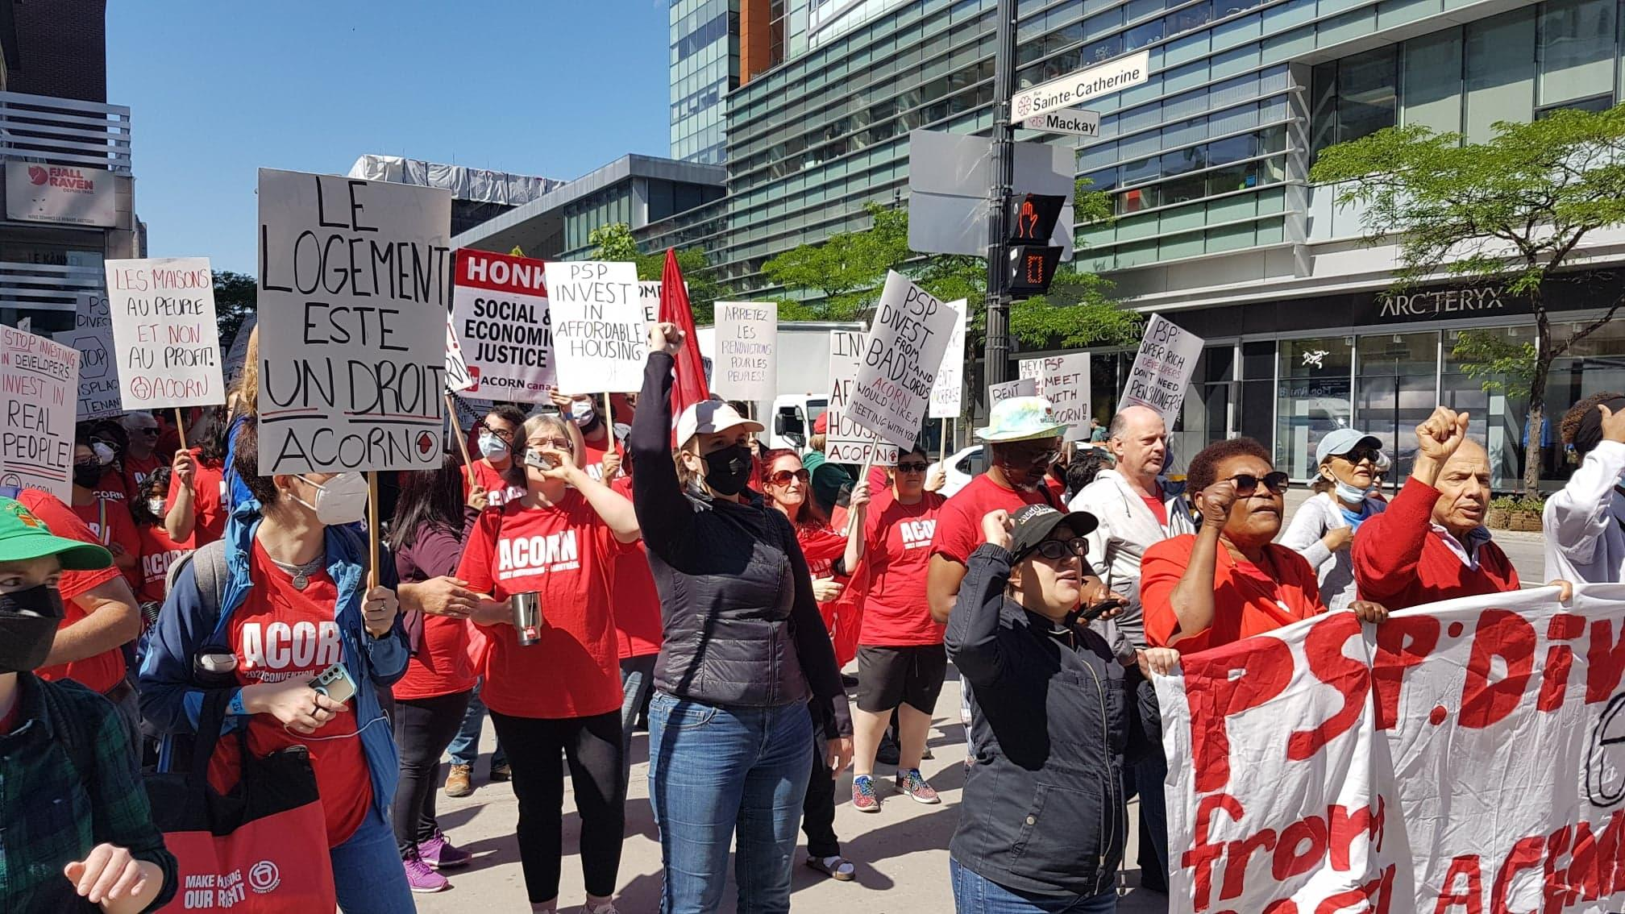
ACORN Canada
Convention 101
Sat, June 15th- Mon, June 17th

Slide 2
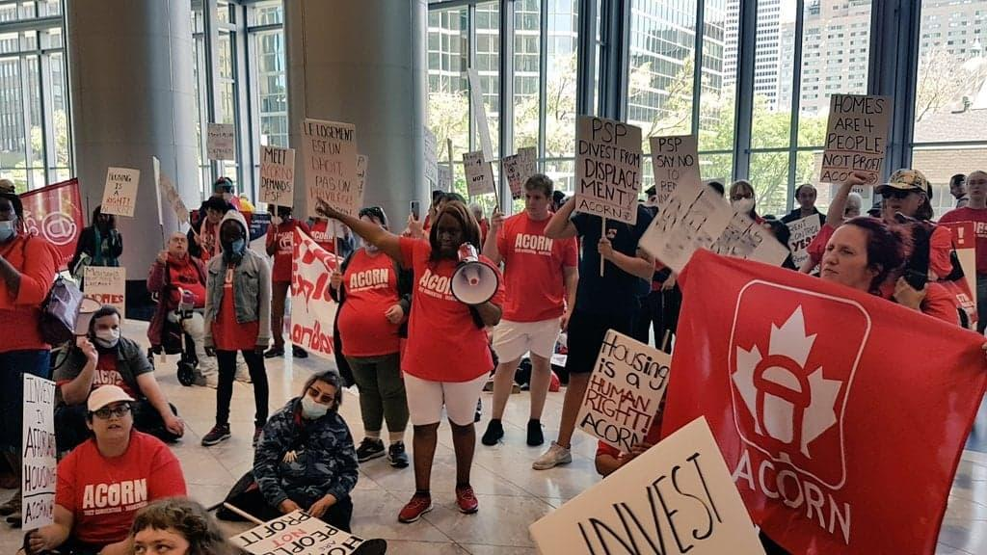
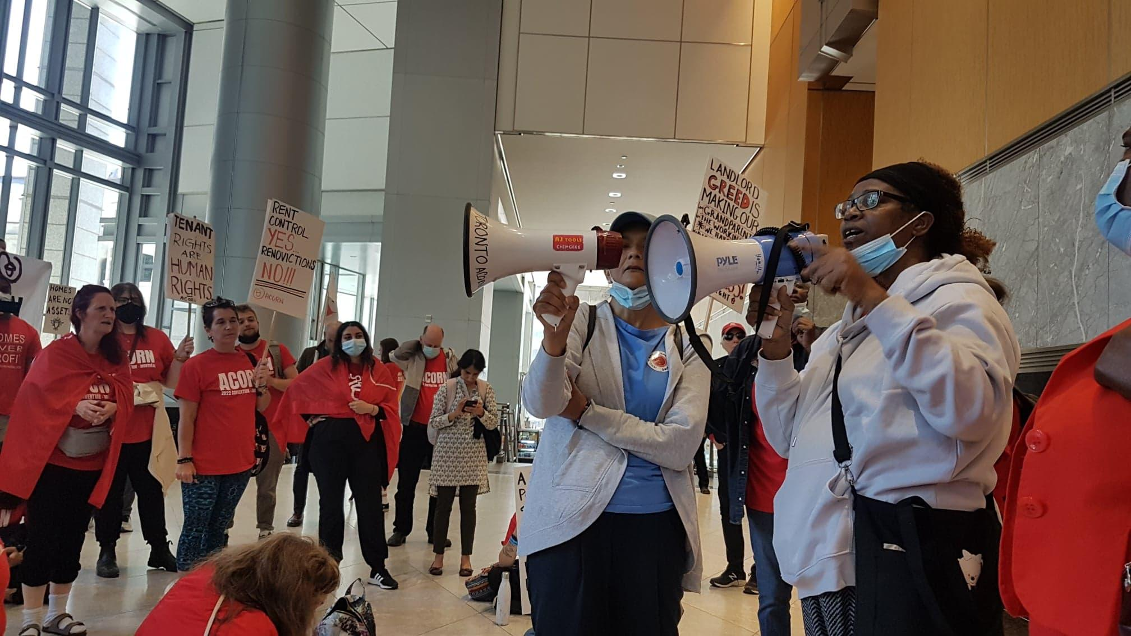
Land Acknowledgements
Introductions
Ground Rules
Everyone is muted during presentations
Stay muted if you’re not speaking
Be respectful during group discussion.
Ask questions, listen to each other and allow others to speak.
Please avoid cross talk and oppressive language

Slide 3
Agenda
What is ACORN
What is Convention
Convention 2024 Updates
Brainstorming Session
Fundraising for Convention
Upcoming Events and Announcements
Other business for remote members

Slide 4
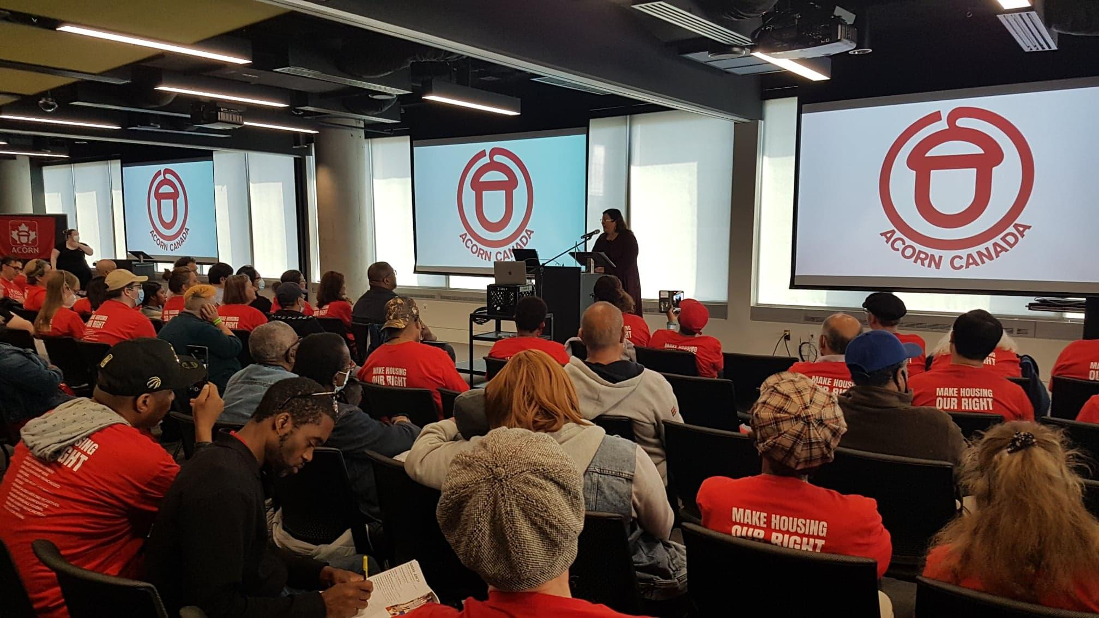
What is ACORN?
ACORN is a membership based community organization of low and moderate-income people fighting for change. We have been active since 2004 and we have 25 chapters in 11 cities across Canada, with 160,000+ members. Our campaigns are focused on social and economic justice and include issues like housing, banking, predatory lending, and the digital divide.

Slide 5
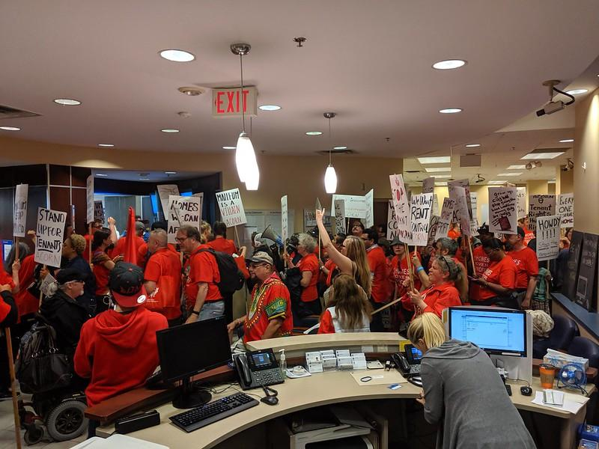
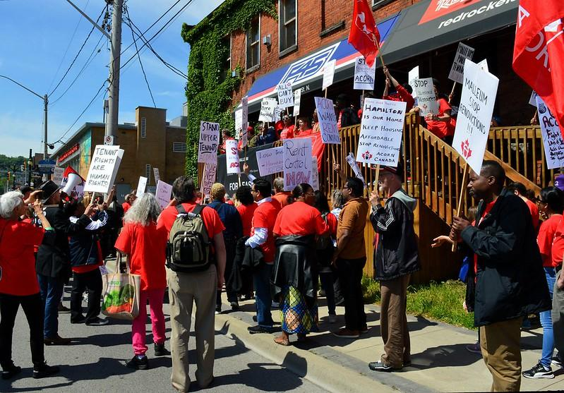
Convention Overview
3 days of workshops, prominent guest speakers (politicians, labour leaders, activists etc), a gala dinner and a BIG action on the last day!

Slide 6
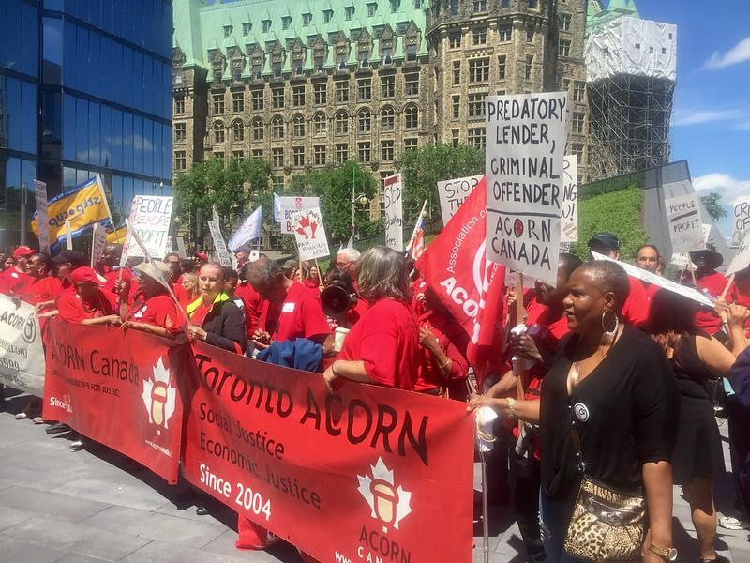
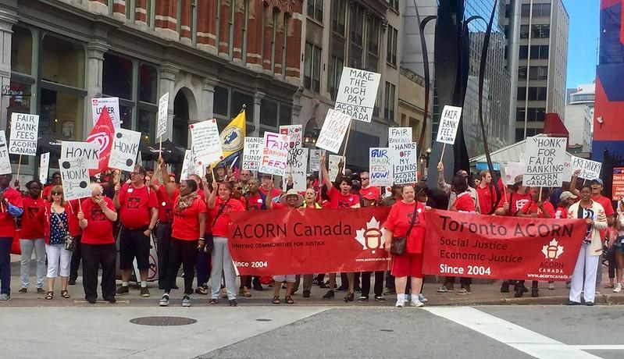
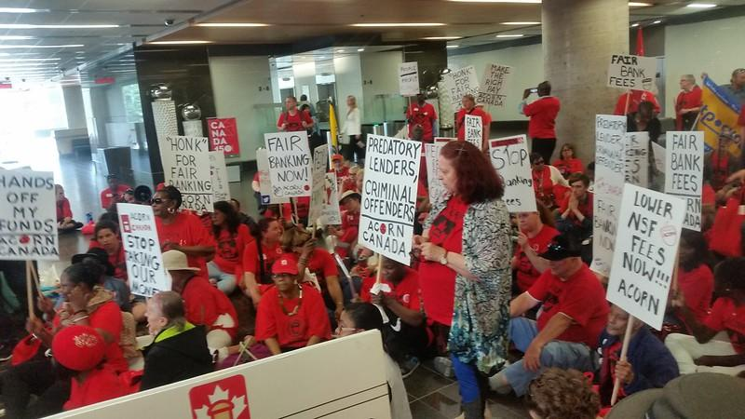
Past Conventions

Slide 7
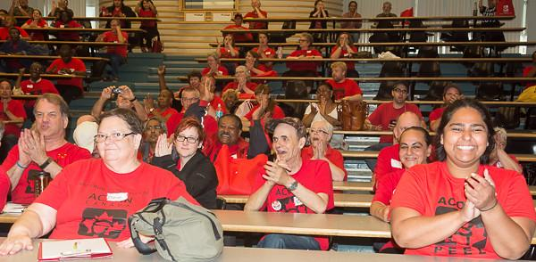
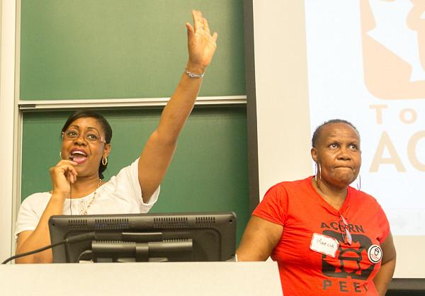
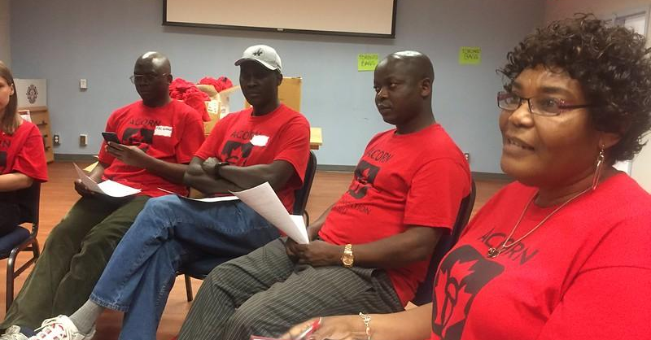
Past
Conventions

Slide 8
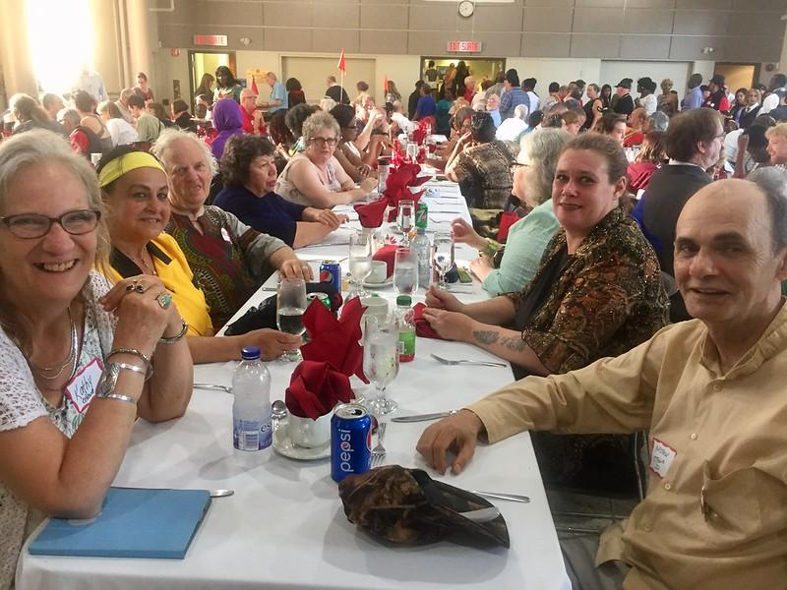
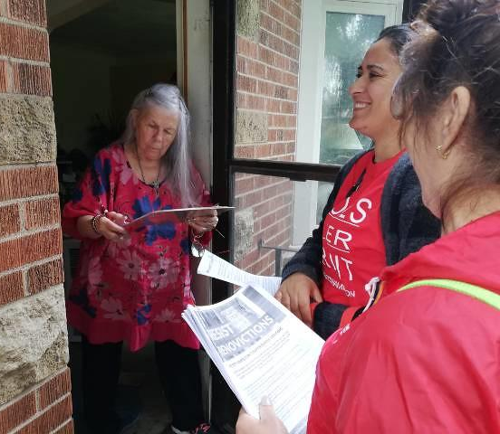
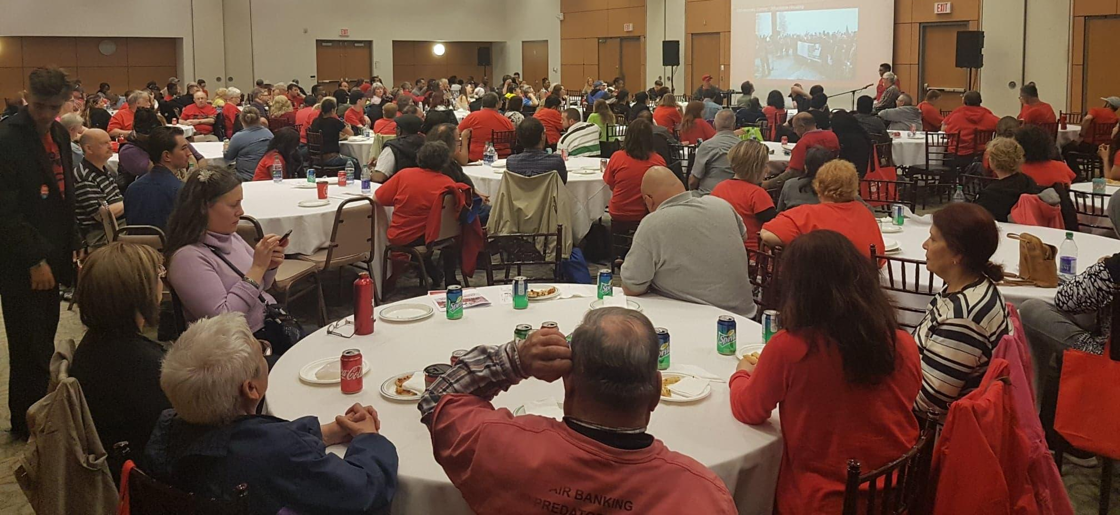
Past Conventions

Slide 9
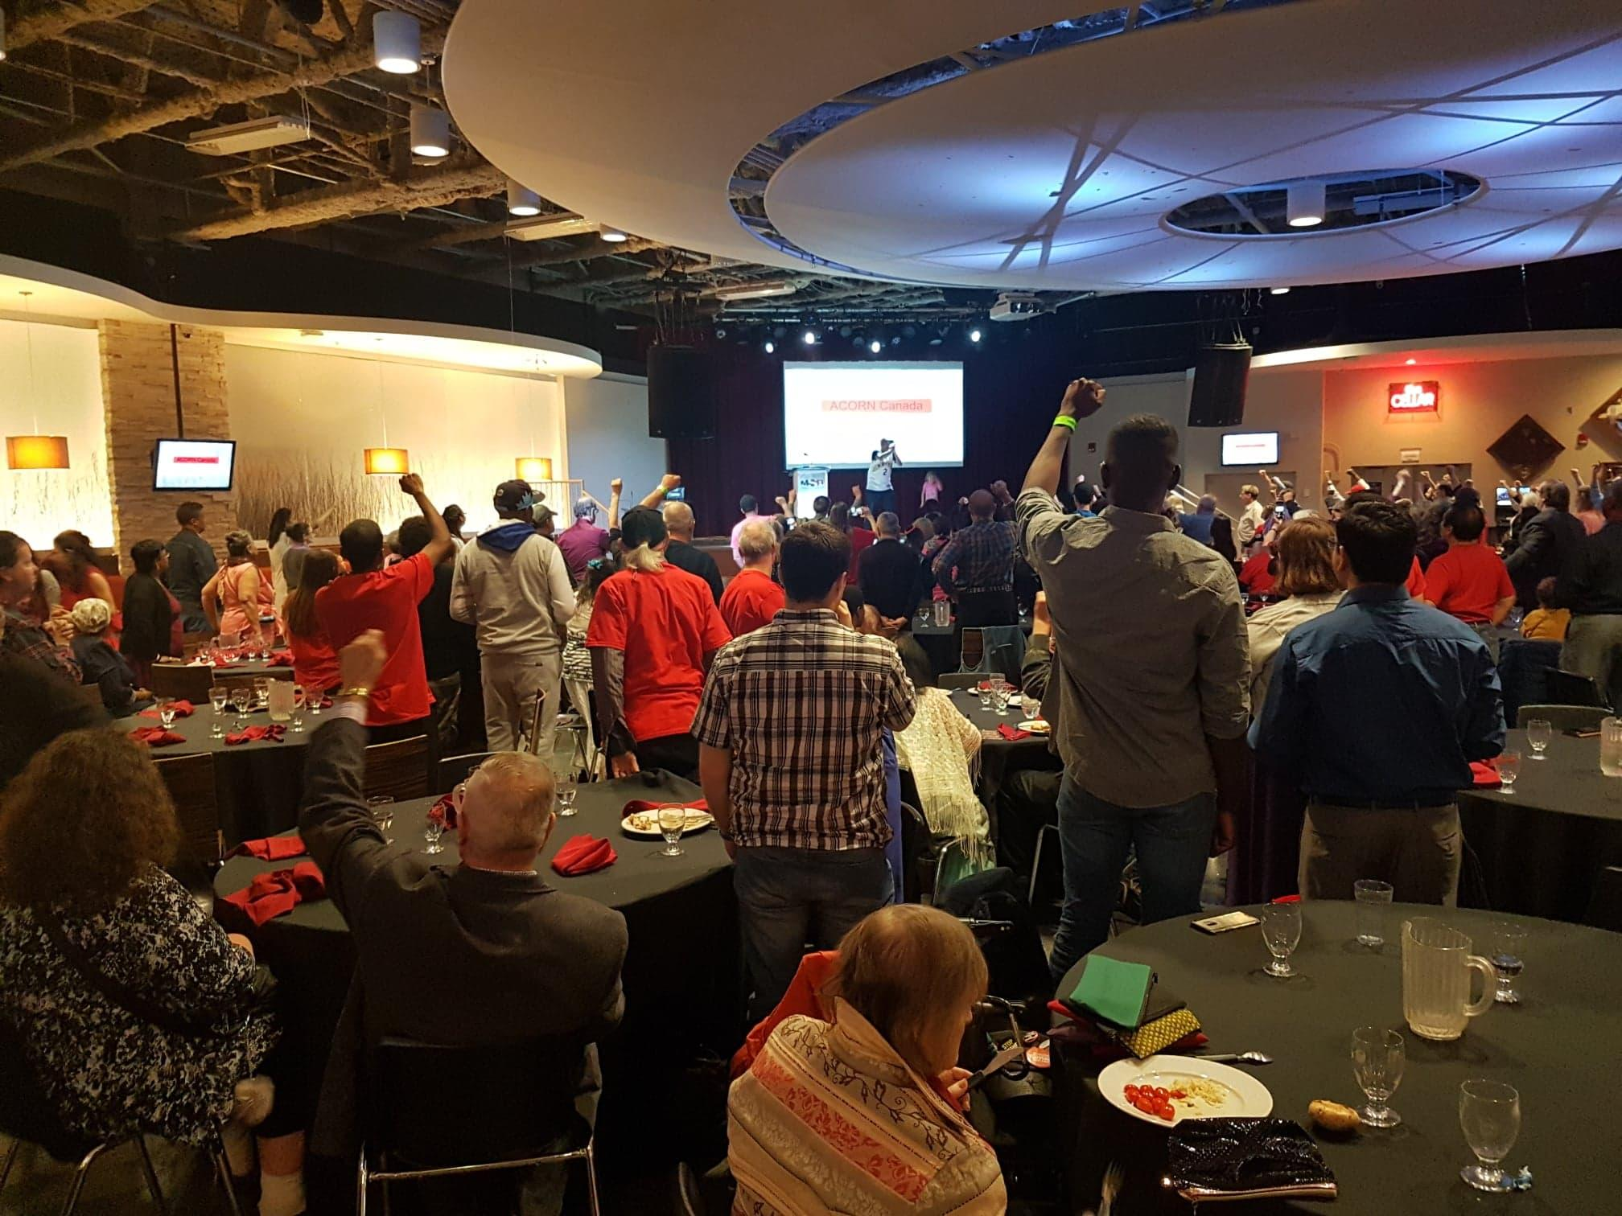
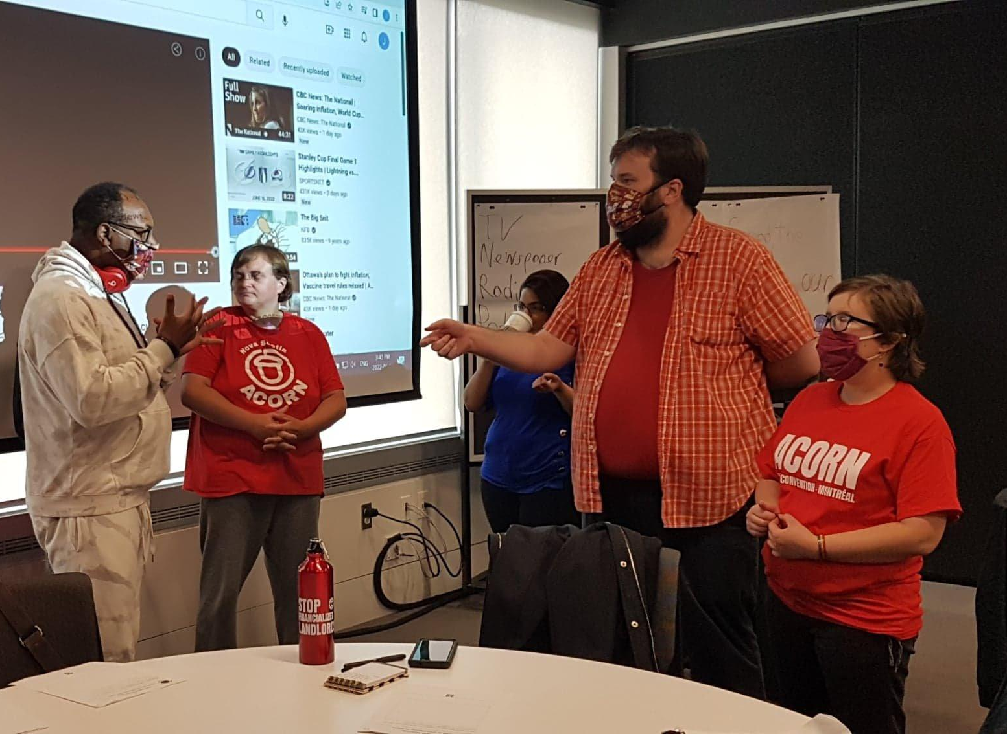
Promo video for 2024:
https://www.youtube.com/watch?v=ljM7y719_0I

Slide 10
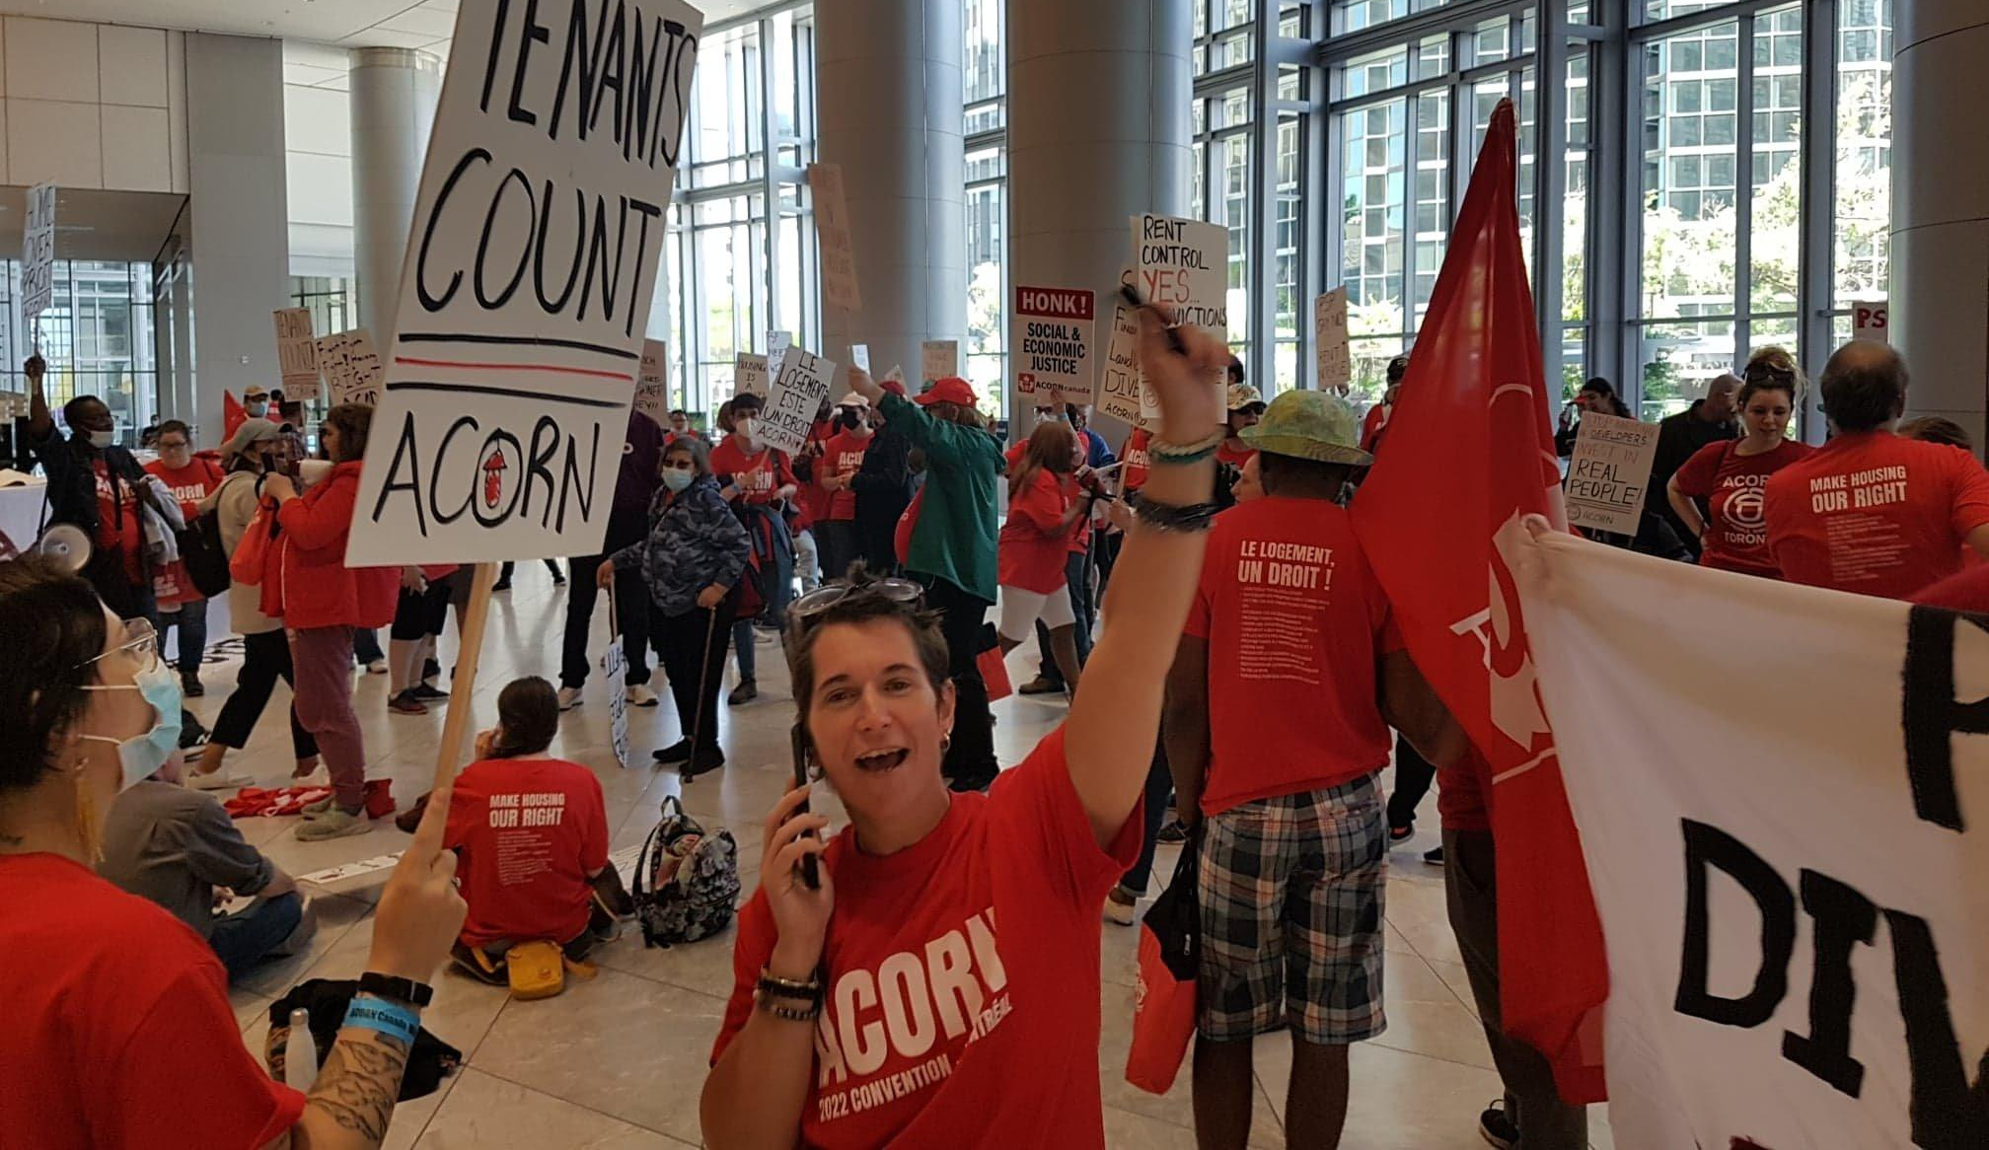
2022 Montreal Convention Highlights:
https://acorncanada.org/video/acorn-canada-national-convention-2022/

Slide 11
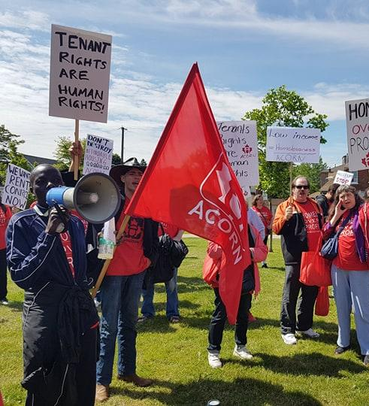
2024 Convention Updates
Saturday, June 15th- Monday June 17th
Durham Region
Rich history of important labour fights
Ontario Technical Institute (99% locked in) - new campus!
Politically important - conservative ridings, vacant MP seat

Slide 12
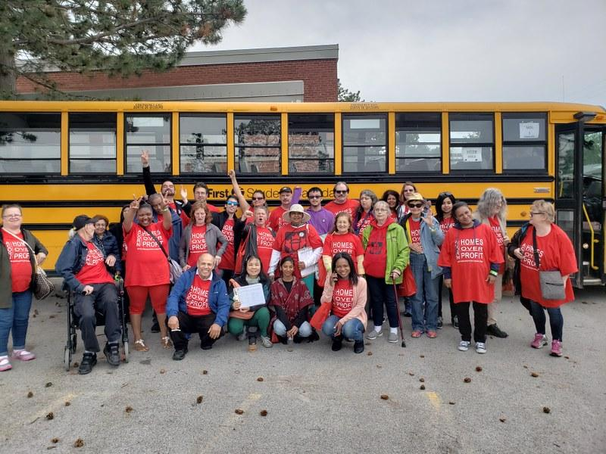
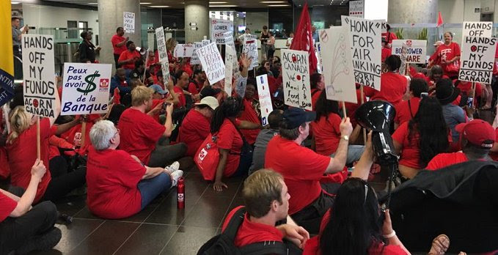
2024 Convention Updates
AB/BC arrive Fri June 14th
ON/Atlantic arrive Saturday June 15th, 2024
Day 1: Check in, workshops, speeches from ACORN cities
Day 2: Plenary, guest speakers, outreach day, reception dinner
Day 3: Big action!!! Head home Monday June 17th, 2024

Slide 13
QUESTIONS?

Slide 14
Brainstorming then Report Back
Potential workshops?
Potential guest speakers?
What national campaign should be the focus of the big action? Ex. Housing, Fair Banking, Internet for All
Potential target for the action?
Other ideas?
Remember to nominate a notetaker to report back!

Slide 15
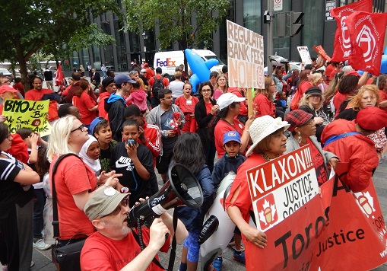
What’s included?
Travel to and from Durham Region
Accommodations
Breakfast, lunch, dinner while at convention
ACORN swag/gift bag
Entry to all events

Slide 16
What’s it cost?
PROVINCE | DEPOSIT | FULL COST (includes deposit) | EARLY BIRD SPECIAL (if chip in deposit by Dec 31st, 2023)
Ontario | $75 | $350-$400 | $300-$350
BC | $100 | $700 | $650
Alberta | $100 | $650 | $600
Atlantic | $100 | $600 | $550

Slide 17
Fundraising
TIPS:
Sell $2 raffle tickets (winner is announced at convention, chance to win $500 )
Sell ACORN calendars
Sponsors/Pledges (like a walk a thon) from friends, family, neighbours or local politicians and unions
Tabling at union conventions, malls, festivals etc
Increase your dues by a bit each month to pay the deposit
TIPS:
Sell $2 raffle tickets (winner is announced at convention, chance to win $500 )
Sell ACORN calendars
Sponsors/Pledges (like a walk a thon) from friends, family, neighbours or local politicians and unions
Tabling at union conventions, malls, festivals etc
Increase your dues by a bit each month to pay the deposit
If you pay your deposit your spot at convention is guaranteed
Money is not a barrier - if you want to come to convention, you’re coming!
Talk to your local organizer about fundraising and other options

Slide 18
Announcements
Register your rent at rentalregistry.ca to help track rising rents!
ACORN Canada 2024 Calendars - get yours from your local office!
Sign the ontario housing online action demanding action from Ford
Stay behind if you’re from a city without an ACORN chapter and want to speak to an organizer!
HAPPY HOLIDAYS!

